Slide 1
State Resources You Can Use
MIST Cluster Meeting
August 5, 2016

Slide 2
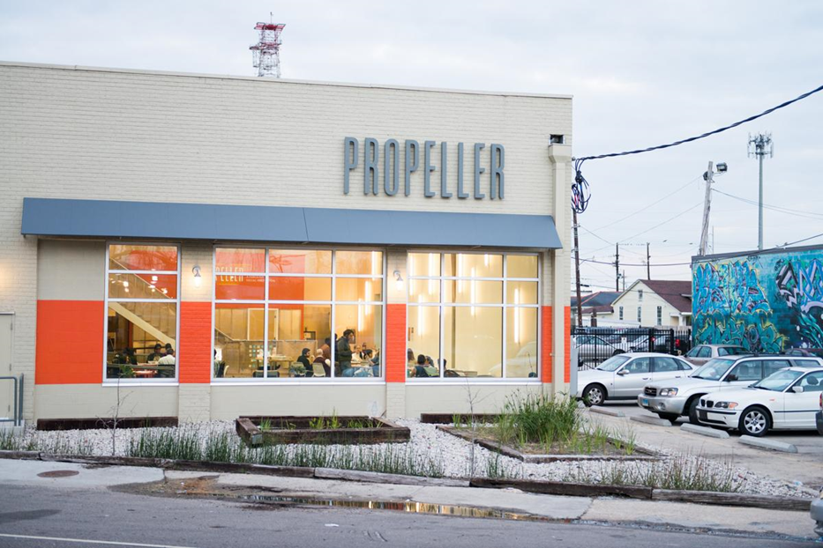
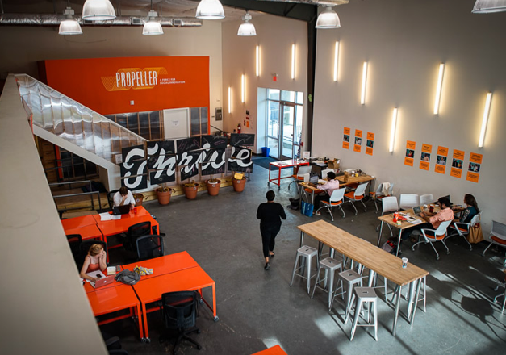
About Propeller
Notes:
Propeller was founded in 2009 to harness the energy of entrepreneurs after Hurricane Katrina. We have been operating out of our building in Broadmoor since 2013 and have upwards of 80 companies, entrepreneurs, and organizations that work out of the space. In addition to providing a great workspace for local innovators in the city, we also support them through our year-long programming that focuses on education, public health, food security, and water management. I work directly in the water sector and am excited to share the opportunities that we offer today.

Slide 3
Water: Sector Strategies
Coastal Restoration
Urban Water Management
Local Water Economy*
Sediment Innovation
Water Quality
Fisheries
Man-made Barrier Islands
Stormwater Retention
and Storage
Maritime Industries
Wetland Mitigation
Resettlement & Resilience
Workforce Development
*must have equity and/or inclusion lens
Notes:
Propeller’s Water Strategies:
Coastal Restoration: Rebuilding efforts, including innovation in use of sediment, man-made barrier island building (future), mitigation and restoration of wetlands.
Initiatives for rainwater and runoff management:
Slowing stormwater (Green Infrastructure) by using bio-retention and infiltration strategies, including rain gardens and bio-swales;
Storing stormwater.
Water quality improvement and monitoring projects.
Maritime industries.
Local water economy with a specific focus on equity and inclusion: Initiatives include workforce development efforts for LMI and minority workers, fisheries, and resilience/relocation of coastal communities.

Slide 4
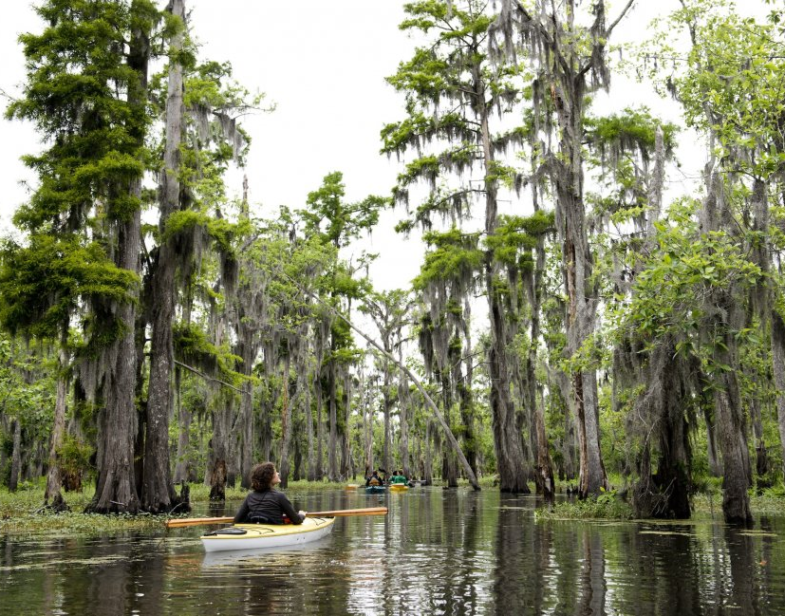
Our work in Water
Water Impact Accelerator
Startup & Growth Track
Water Challenge Day
Water convenings and workshops
Water policy initiatives

Slide 5
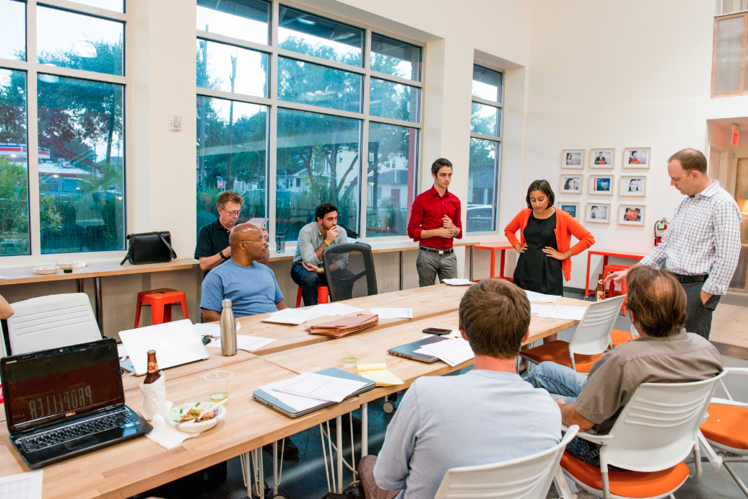
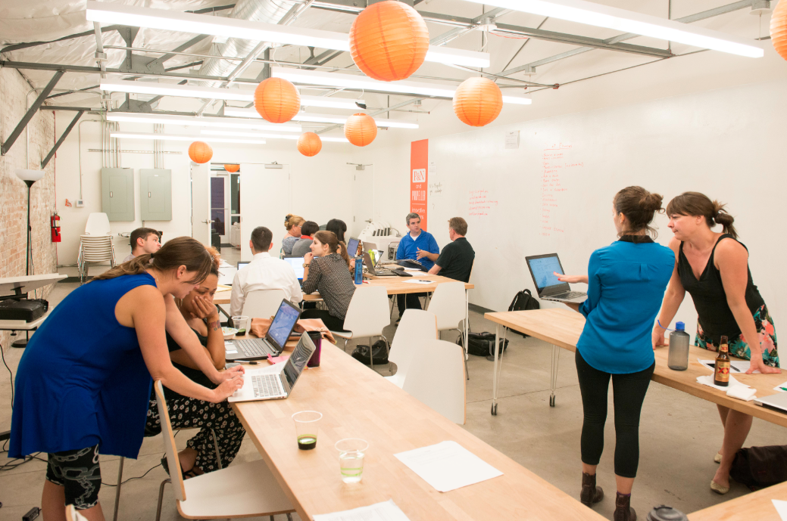
Impact Accelerator
Startup Track: September - December 2016
Growth Track: March - June 2017
One-on-one business coaching
Technical assistance network
Office space
Sector networking

Slide 6
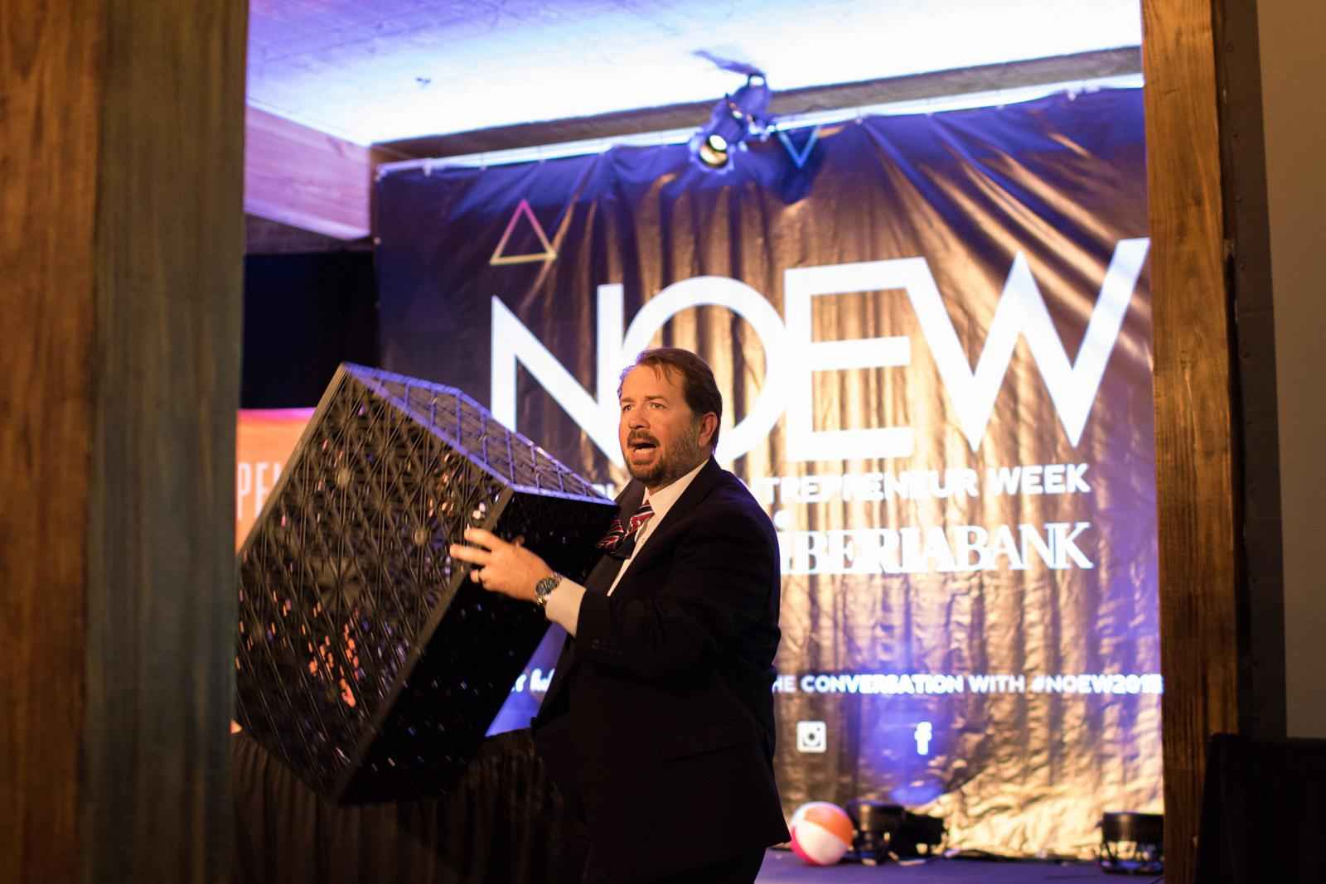
Water Challenge Day & Convenings
Water Challenge Day
Industry expert-led discussions
$15,000 pitch competition
New Orleans Entrepreneur Week
Other convenings:
2017 Coastal Master Plan Update
Sewerage & Water Board Green Infrastructure Grantee Public Unveiling
Regional Approaches to Water Management

Slide 7
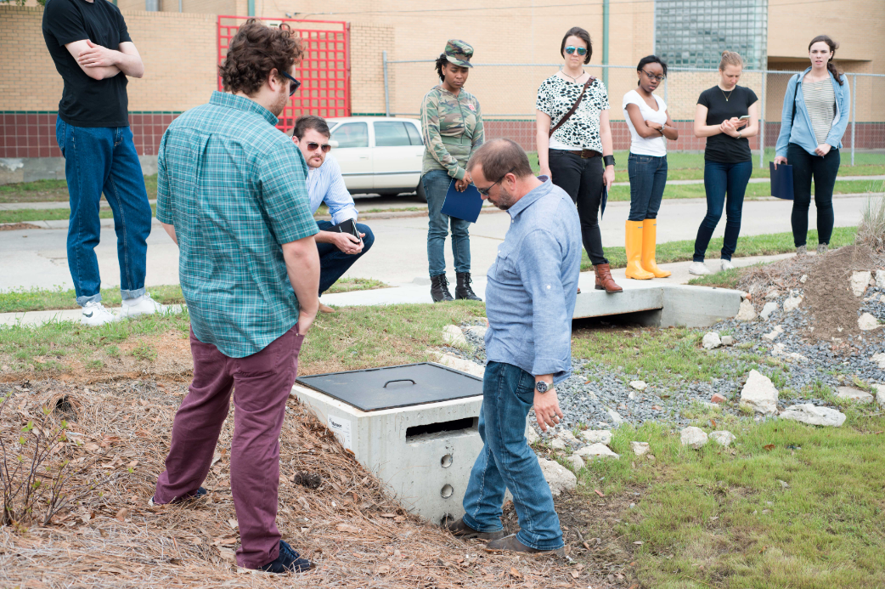
Water: Policy Initiatives
Partnering to provide recommendations to CPRA to increase local small business contracting in Southeast Louisiana
Article 23 of the Comprehensive Zoning Ordinance (CZO) to increase sustainable stormwater management in New Orleans

Slide 8
Connect with us!
www.GoPropeller.org
@GoPropeller
Email me: eeckland@GoPropeller.org
Sign up for our newsletter!

