Slide 1
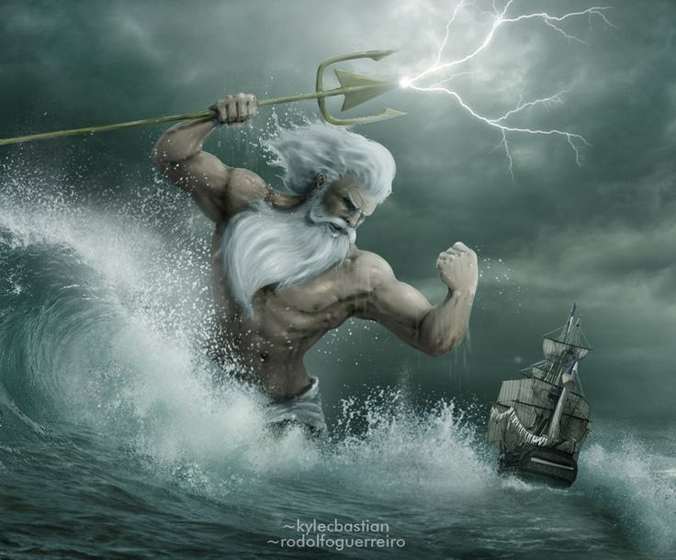
Proteus Technologies LLC
Sean Griffin
President
Proteus Technologies LLC
1040 Old Spanish Trail
Suite 7
Slidell, LA 70458
4 August 2016
Ph: 985-231-2222
sean@proteustechnology.com
Proteus Technologies LLC

Slide 2
About Proteus Technologies LLC
Founded by Sean Griffin, June 2010
3000 square foot facility located in Slidell, LA
5 Employees
Fully equipped electronics test and assembly lab
CAD software for mechanical and electronic design and simulation
Mechanical equipment includes three 3D printers, pressure tank, milling machine, band saw, fork lift, vacuum oven, vent hood, compressor, hand tools, sand blast hood, welder, etc.
Proteus Technologies LLC

Slide 3
What We Do
Consulting/Design Engineering
Oceanographic Instrumentation
Electronic Design and Development
Prototype Development
Light Manufacturing
Marine Acoustics
Mechanical Design
Deployment and Recovery of Marine Systems
Proteus Technologies LLC

Slide 4
Clients
Naval Research Laboratory
Naval Oceanographic Office
Naval Surface Warfare Center Panama City, FL
Expeditionary Warfare Center (EXWC), Port Hueneme, CA
University of Louisiana Lafayette
St. Tammany Parish
Woods Hole Oceanographic Institute
NOAA
Booze Allen Hamilton
DDL Omni
Thermoprobe
DMR
Etc.
Proteus Technologies LLC

Slide 5
Success Stories
LADC GEMM
NOAA Phase I and Phase II SBIR awards
NSWC Panama City
NRL Quadraped
Proteus Technologies LLC

Slide 6
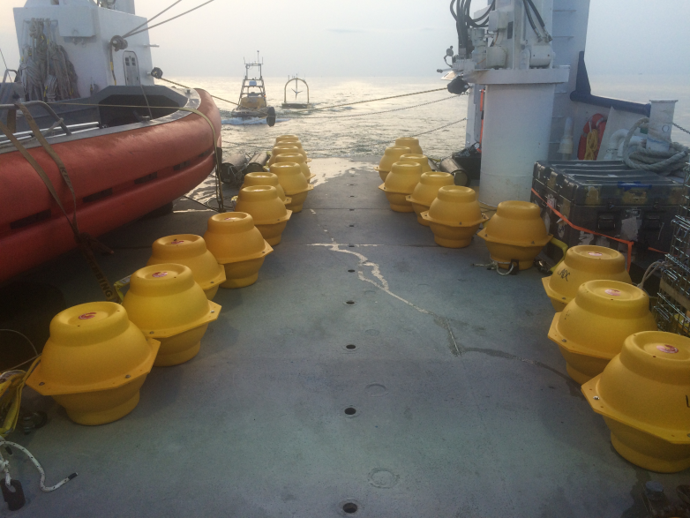
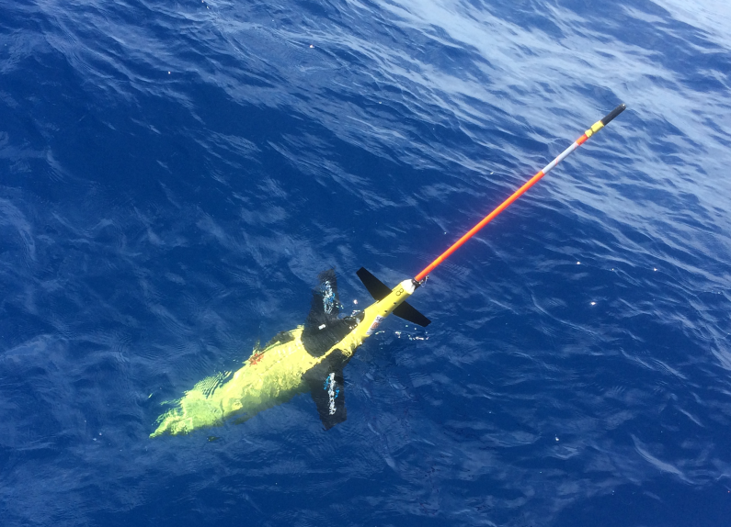
LADC GEMM
3 year program monitoring marine mammals in the Gulf of Mexico with Passive Acoustics
University Consortium with ULL as lead institute
Proteus Technologies LLC

Slide 7
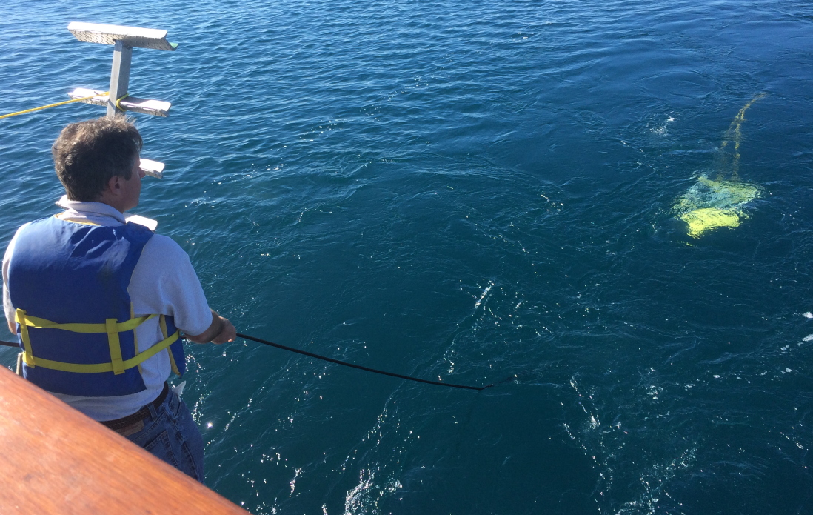
NOAA Phase I and Phase II SBIR
Solicitation: NOAA2015-1 & 2
Topic: 8.2.1F
Affordable Robust Nonlinear
Towed Hydrophone Arrays
Proteus Technologies LLC Proprietary

Slide 8
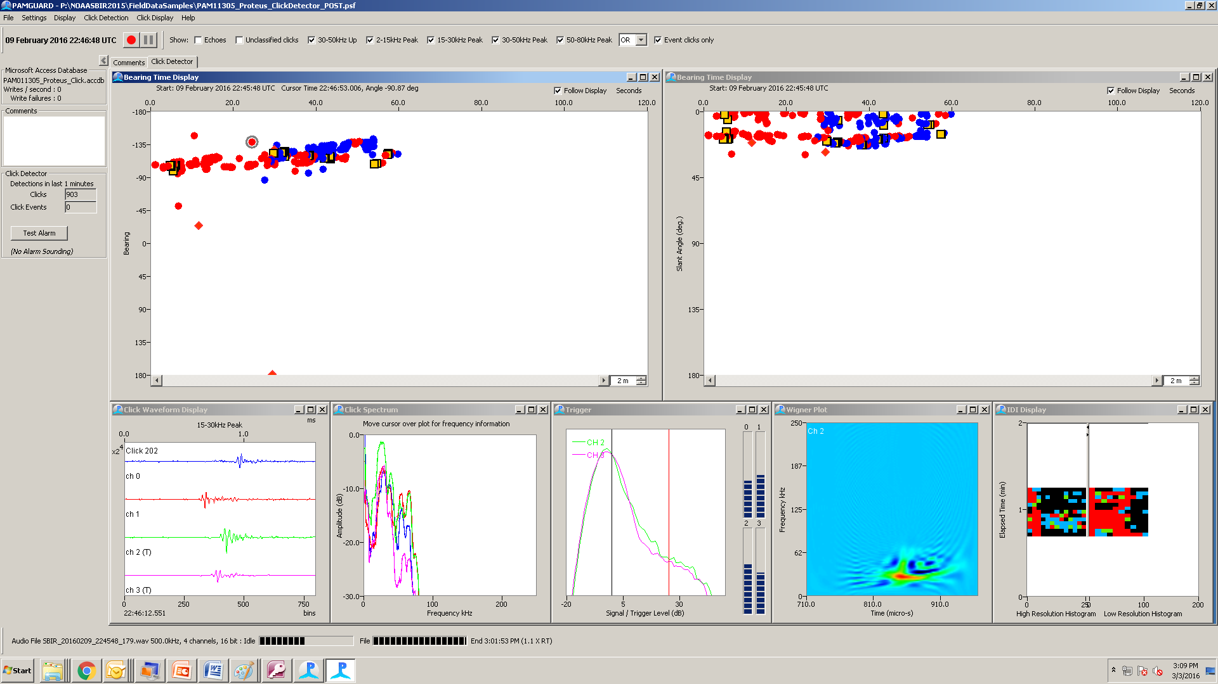
PAMGuard Detection of Dolphin Pod off Port Beam 9 Feb 2016, ~22:47 UTC, 8 Knots
group of dolphins 400m off port beam
echoes on dolphin clicks
Proteus Technologies LLC

Slide 9
NSWC Panama City
Seaport E contracts
Working with NSWC since 2010
Designing Form/Fit/Function replacements for various Q32 and Q48 sonar components
Supporting test and calibration
Proteus Technologies LLC

Slide 10
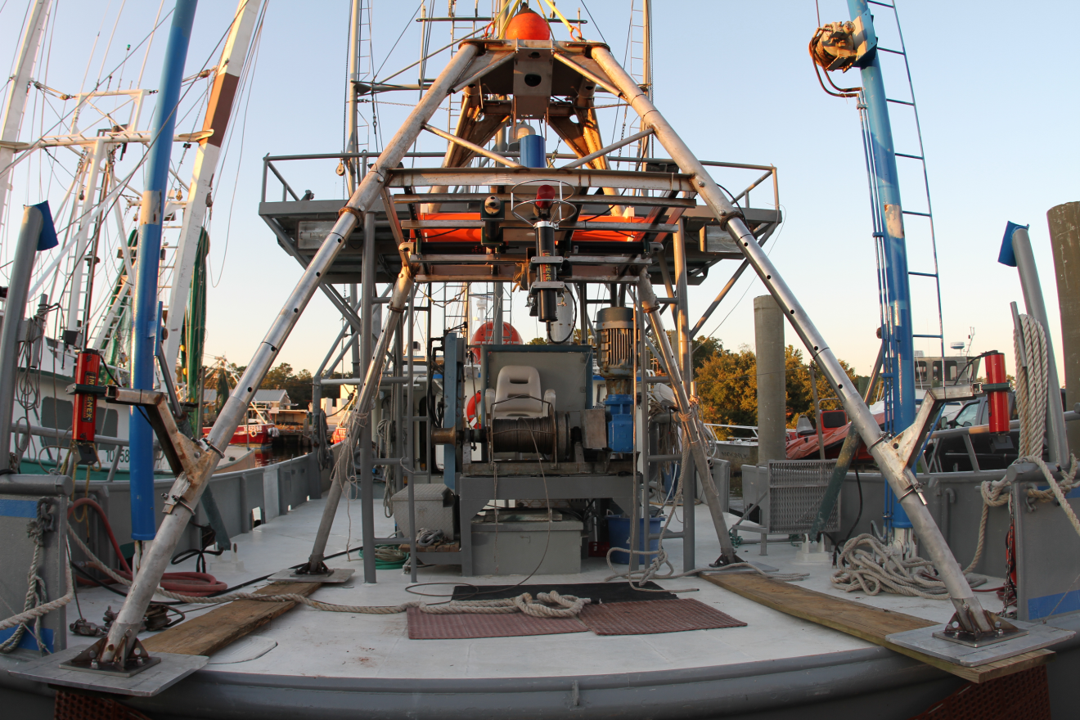
Naval Research Laboratory Quadraped
Frame and automated instrumentation for measuring sediment mobility properties. Uses sector scan SONARs, pencil beam SONARs, ADCP’s and camera systems. 120 day endurance
Proteus Technologies LLC

Slide 11
Questions?

