Slide 1


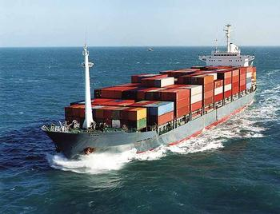
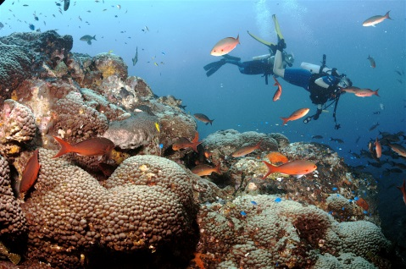
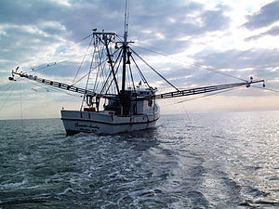
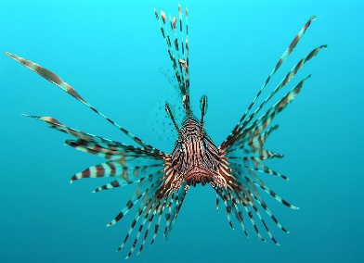
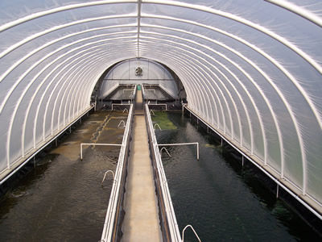
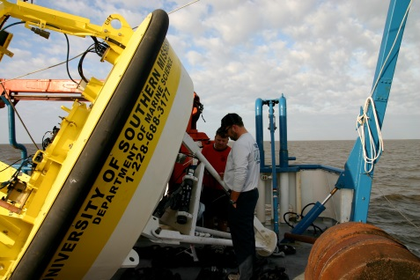
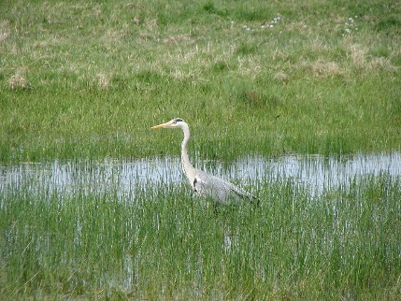
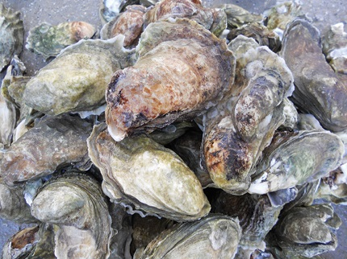
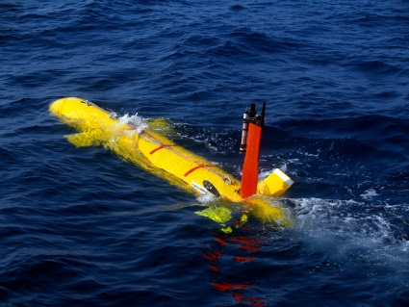

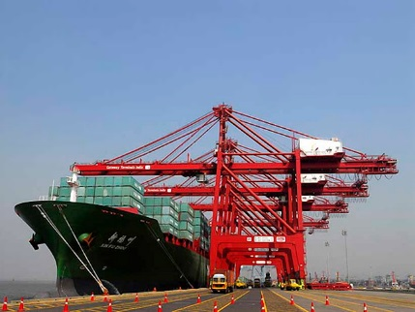
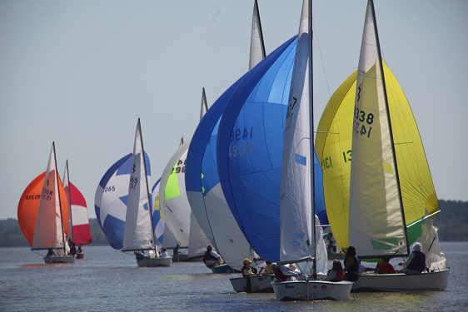




2016: Yearend Overview
Where we have come from, where we are, and where we are going!
©
Presented at the 2nd Annual Marine Industries Science & Technology Forum & Small Business Summit – New Orleans
August 5th, 2016
#SBAHQ-14-C-0012
Business & Innovation Assistance Center

Slide 2



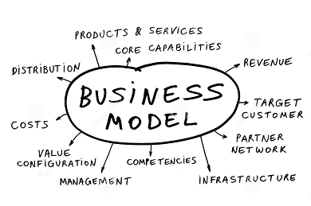


Outline:
2016: An Overview
The MIST Cluster – An Overview
Economic Drivers and MIST “States Strategy”
Small Business Growth of the MIST Cluster
Evolving the MIST Cluster Business Model
Looking Forward
Business & Innovation Assistance Center

Slide 3

The MIST Cluster
2016: An Overview
Business & Innovation Assistance Center

Slide 4
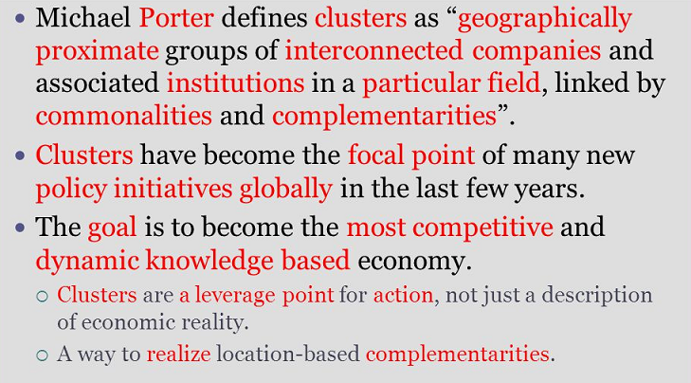
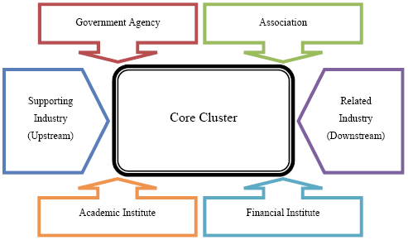

What is a Cluster?
2016: An Overview
Business & Innovation Assistance Center

Slide 5
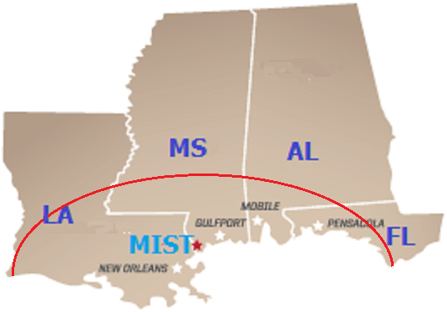
What is the MIST Cluster?
2016: An Overview
The Marine Industries Science & Technology (MIST) Cluster is the regional group of organizations involved in the development and implementation of applied technology applications for operating in, working around, and/or monitoring the marine and coastal environments. These organizations (large and small businesses, federal & state agencies, universities, and nonprofits) through their applied technology efforts support other related marine industries in the region which include:
Coatings
Commercial and recreational fishing
Shipbuilding
Aqua-Mariculture
Oil & Gas and Energy
Port & Harbor Operations
Shipping
Environmental Restoration & Recovery
And others
Sensors
Software
Robotics
Business & Innovation Assistance Center

Slide 6
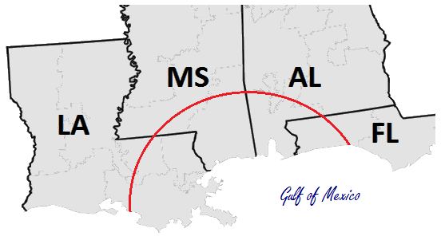








































Institutional Members
2016: An Overview
Government Agencies – Federal & State
Academic Institutions
Associations
Financial
Business & Innovation Assistance Center

Slide 7
































Core Cluster
2016: An Overview
Now 70+ Formal Small Business Cluster Members and Growing!
8 Formal Large Business Cluster Members
23 Original Formal Small Business Cluster Members
Business & Innovation Assistance Center

Slide 8


MIST Cluster “Program”
2016: An Overview
Organizationally the MIST Cluster currently functions as a “Program” supported in part under an SBA Regional Innovation Clusters (RIC) contract – Base year plus 4 option years.
MIST Cluster program is lead by USM working with its partners – LSU, MSET and Innovate Mississippi – and its network members.
Purpose is to more formally organize the organic cluster members in order to help give an identity and recognition of the MIST Cluster.
A primary focus is the development and promotion of the cluster’s small business members.
Business & Innovation Assistance Center

Slide 9


Support to Small Businesses
2016: An Overview
The MIST Cluster assists the development and promotion of its small business members through a set of Direct Services provided by the MIST Cluster Partners and Linking Services provided by the MIST Cluster’s network members (i.e. PTAC, SCORE, etc.).
Direct Services:
Linking Services:
Business training
Business counseling/consulting
Mentoring
Technology Transfer counseling
Commercialization of R&D Results
SBIR/STTR Engagement
Supporting Facility Clearance and holding personal clearances
Export readiness counseling/consulting
Support to underserved communities
Customer base with federal agencies
Networks and partnerships
Showcase and demonstration opportunities
Regional market development
Assist in ascertaining federal agency technology development requirements and priorities, matching; and/or operationalizing cluster technology and capabilities to best meet these needs
Facilitate opportunities for accessing new resources and markets
Business & Innovation Assistance Center

Slide 10

Economic Drivers and MIST “States Strategy”
2016: An Overview
Business & Innovation Assistance Center

Slide 11

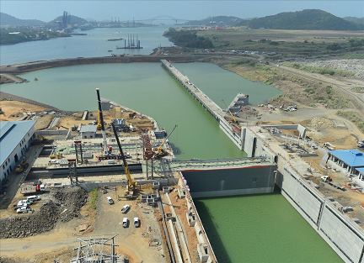
2016: An Overview
Significant New Economic Drivers!
    BP Oil Spill Settlement $20 Billion – Approved April 4, 2016
    Panama Canal Expansion Project – Opened June 26th 2016
Business & Innovation Assistance Center

Slide 12
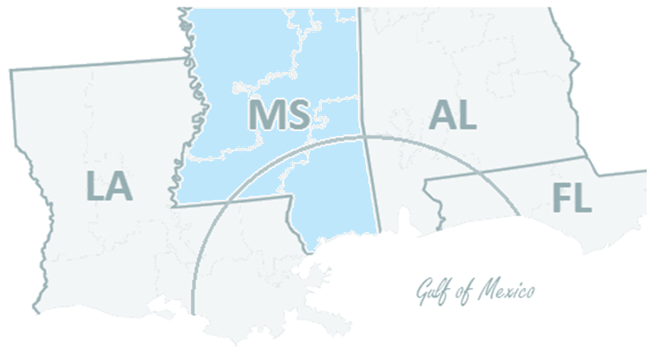
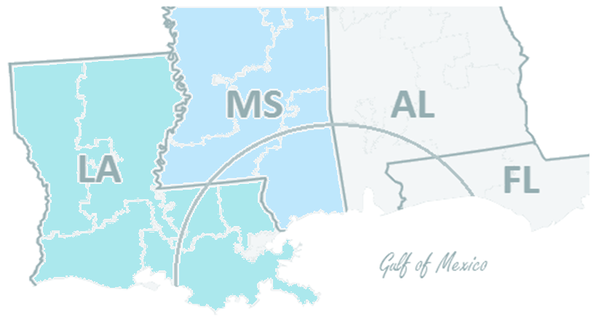
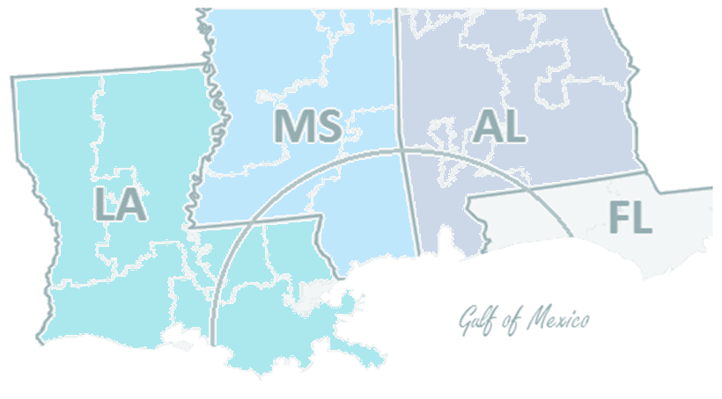
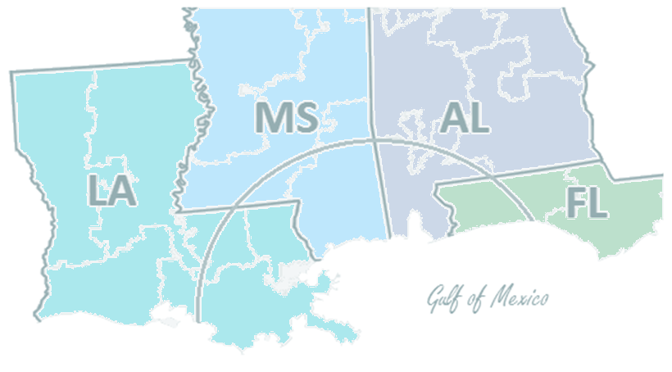



2016: An Overview
The MIST “States Strategy”
    Base year worked from Cluster’s core and focused on growing network in MS.
    Under Option Year 1 turned focus on building the network in LA.
    Under Option Year 2 focus turns to building the network in AL.
    Under Option Year 3 focus will turn to building the network in FL.
    Option Year 4 will be a capstone year bringing it all together.
    Goals:
    Build Cluster’s brand/identity in each state.
    Build network and network of resource partners.
    Increase competitive advantages for members and Cluster as a whole.
Business & Innovation Assistance Center

Slide 13

Small Business Growth of the MIST Cluster
2016: An Overview
Business & Innovation Assistance Center

Slide 14




MIST Cluster Year 1 Impact (2014-2015)
2016: An Overview
Provided Direct and Linking Services to over 70 small businesses in the region.
Over $27 million in contracts and grants awarded to small businesses assisted.
Over $600,000.00 in SBIR/STTR contracts & grants awarded to small businesses assisted.
MIST Small Business members reported least 59 new full time employees (FTE) and 5 part-time employees.
Business & Innovation Assistance Center

Slide 15




MIST Cluster Year 2 Highlights!
2016: An Overview
Assistance provided to $95 million IDIQ SDVOB proposal currently under review by Army Corp ERDC in Vicksburg, MS.
Over $1,000,000.00 in SBIR/STTR contracts & grants awarded to small businesses assisted in Year 2! (3 current NOAA SBIR awardees!)
Continued strong membership growth – nearly 30% increase to now over 70 formal small business members.
Presentation on our RIC made to the Joint House –Senate Oceans Caucus Meeting in Washington D.C.
Business & Innovation Assistance Center

Slide 16
Evolving the MIST Cluster Business Model
2016: An Overview
Business & Innovation Assistance Center

Slide 17
Main issues!
2016: An Overview
The MIST Cluster region extends over 4 states!
Potential “state” related issues may not effect all members.
Some key organizations and agencies have specific state territories.
Some key organizations may be in competition (e.g. ports).
Limited Resources – Staff, funds, etc.!
Sustainability!
Business & Innovation Assistance Center

Slide 18
Looking Forward!
2016: An Overview
Business & Innovation Assistance Center

Slide 19

Looking Forward!
2016: An Overview
Upcoming events:
6th Annual Oceans In Action: Workshop & Industry Day – Aug. 17th-18th, Stennis, MS
Supporting annual meeting – September 8th, Gulfport, MS
MIST Small Business Summit/Stennis Business Consortium Quarterly Meetings – Sept. 6th and Dec. 6th
…and more!
Business & Innovation Assistance Center

Slide 20

Question?
2016: An Overview
©
©
Business & Innovation Assistance Center

