Slide 1
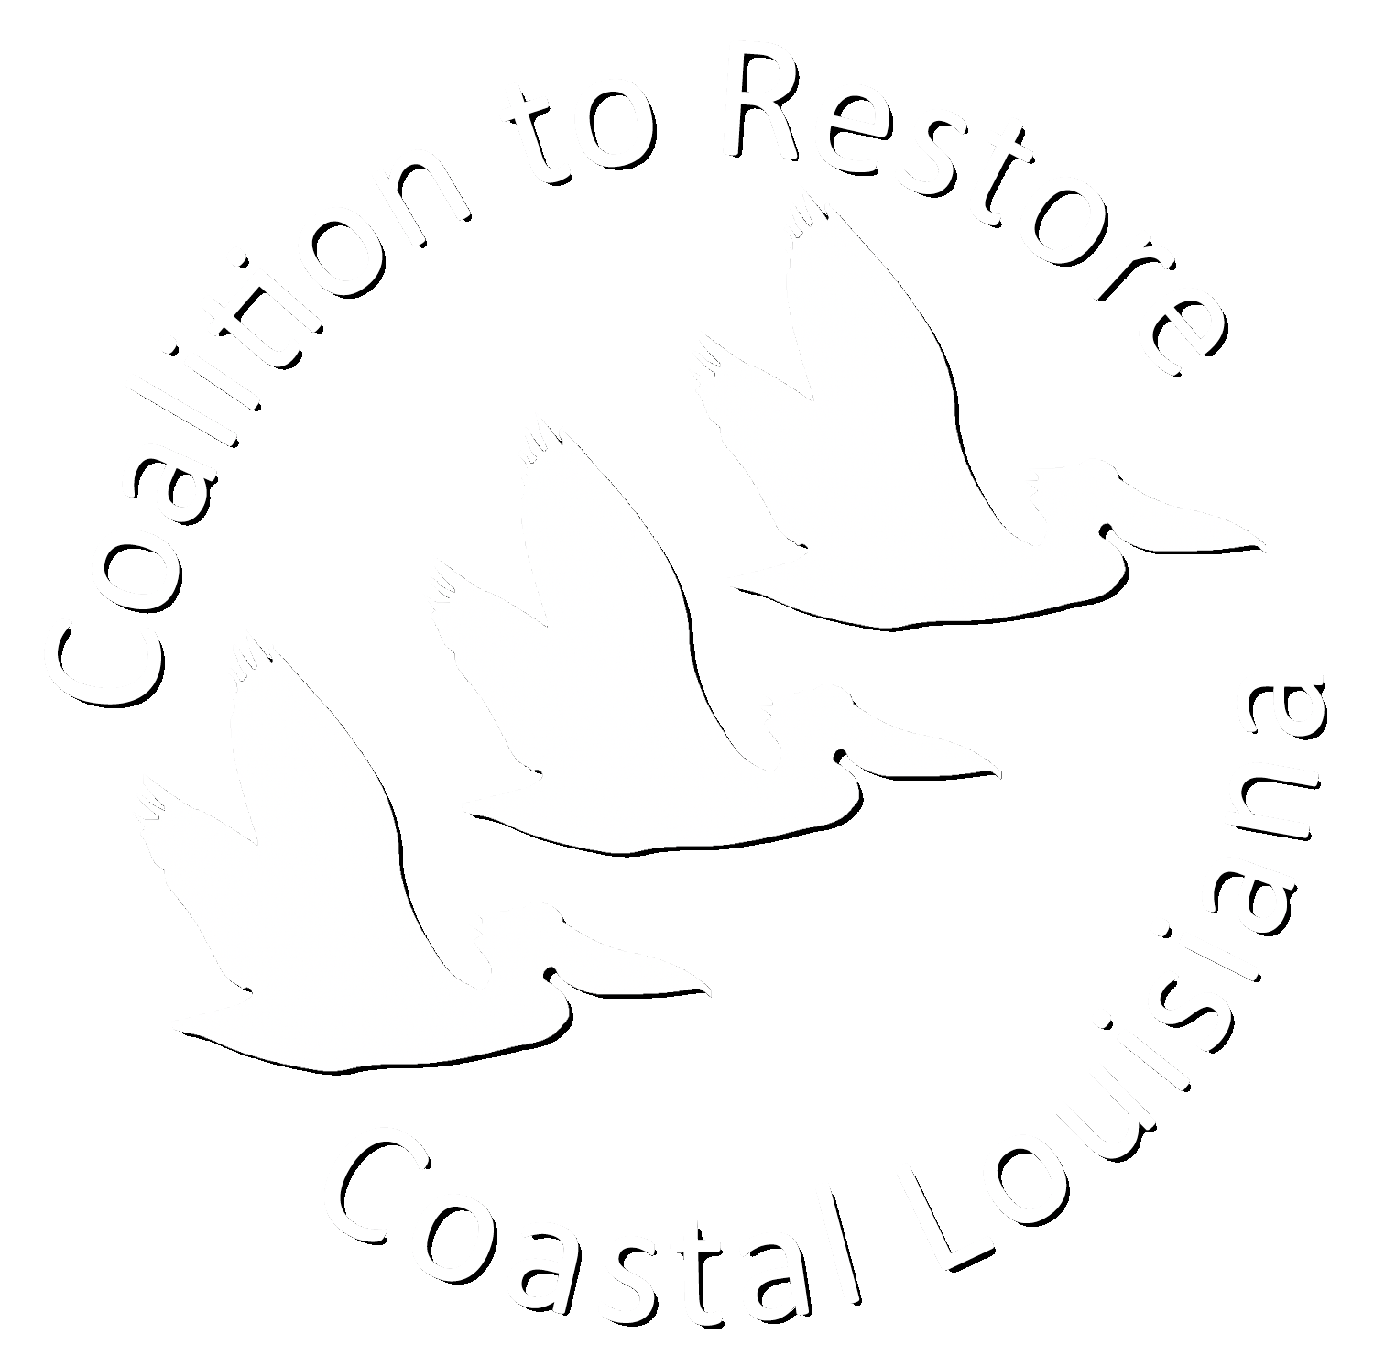
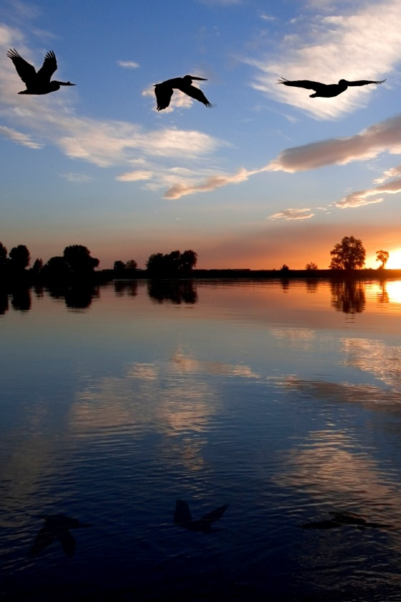

Slide 2
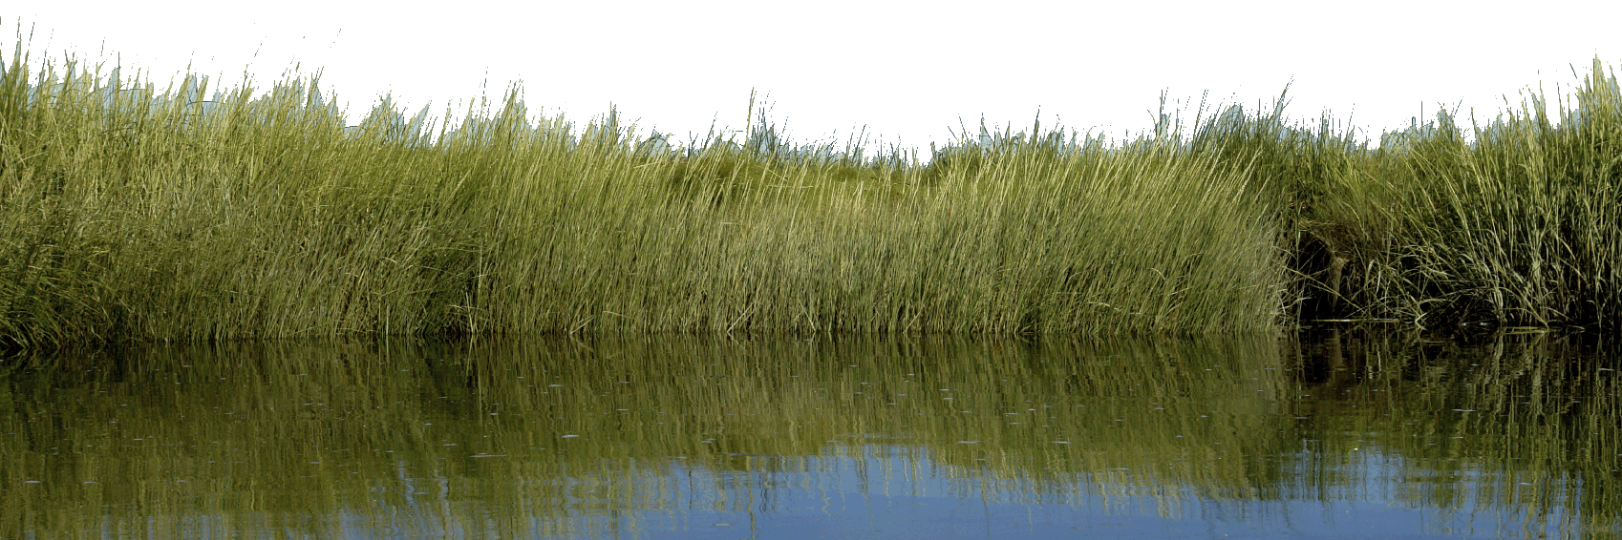
MISSION and VISION
MISSION: To drive bold, science-based action to rebuild Coastal Louisiana through
outreach, restoration and advocacy.
VISION: A thriving Coastal Louisiana sustained by systems that support healthy wetlands and barrier islands, benefitting people and nature.

Slide 3

Our Coast Without Action
Mississippi River
Atchafalaya River
Baton Rouge
Lafayette
New Orleans
YEAR 2100
Potential to lose an additional 770 – 1,750 square miles of land over the next 50 years
Source: Blum and Roberts 2009
Grand Isle

Slide 4
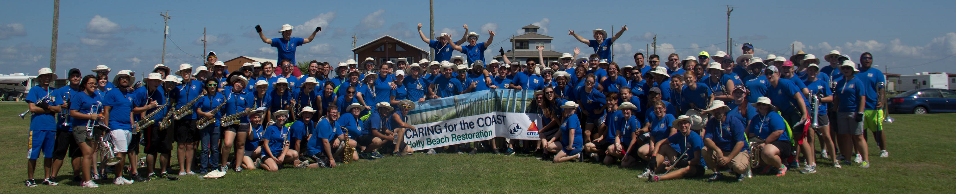
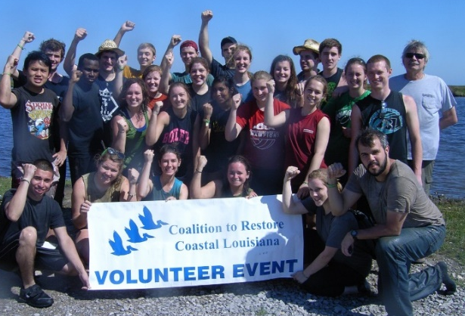
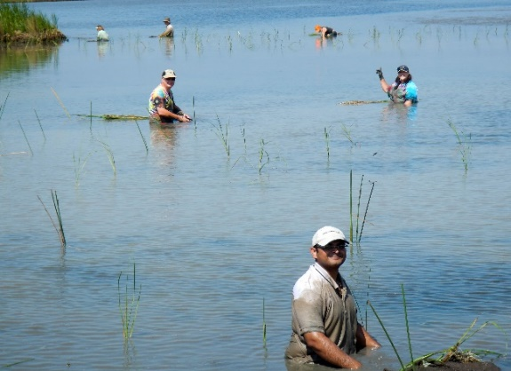
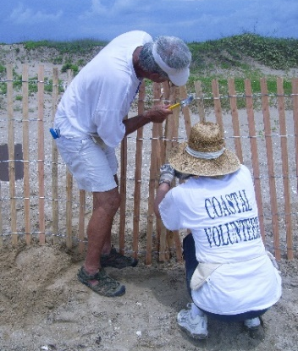
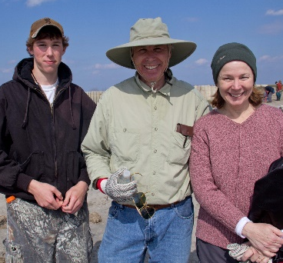
Habitat Restoration Program
CRCL volunteers have planted more than
3,000,000 native plants on more than 4,500 acres of coastal wetlands.
Coalition To Restore Coastal Louisiana

Slide 5
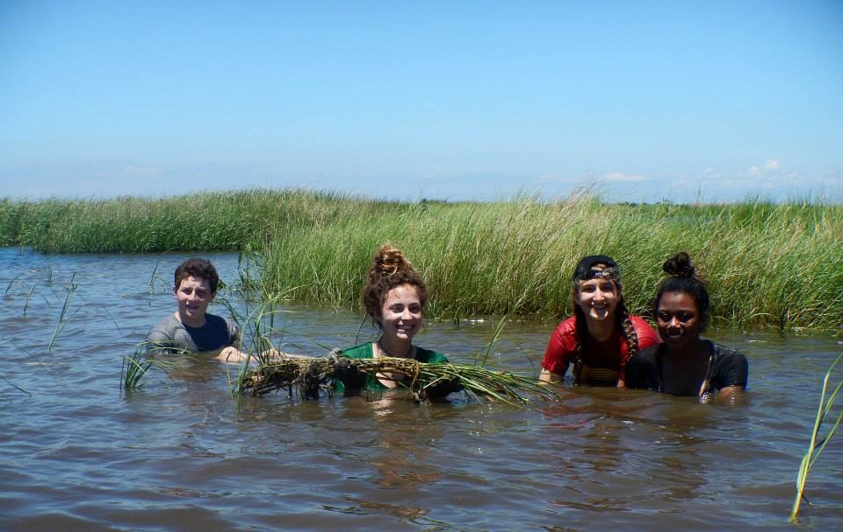
Habitat Restoration Program
CRCL has engaged 13,000+ volunteers since 2000.
Coalition To Restore Coastal Louisiana

Slide 6
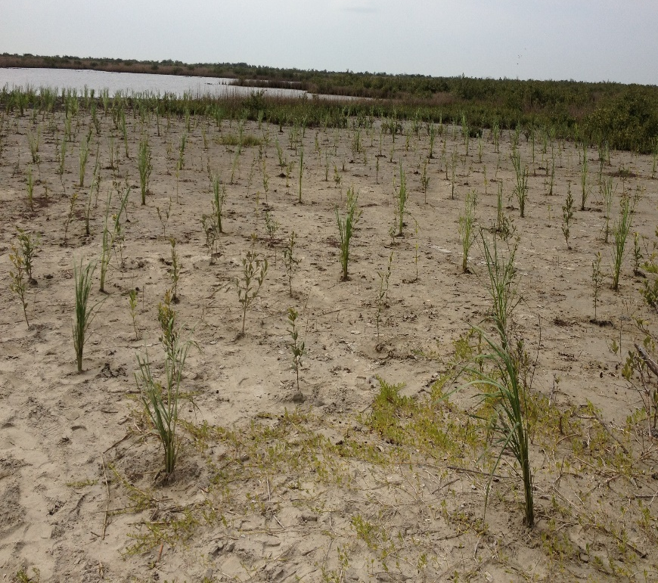
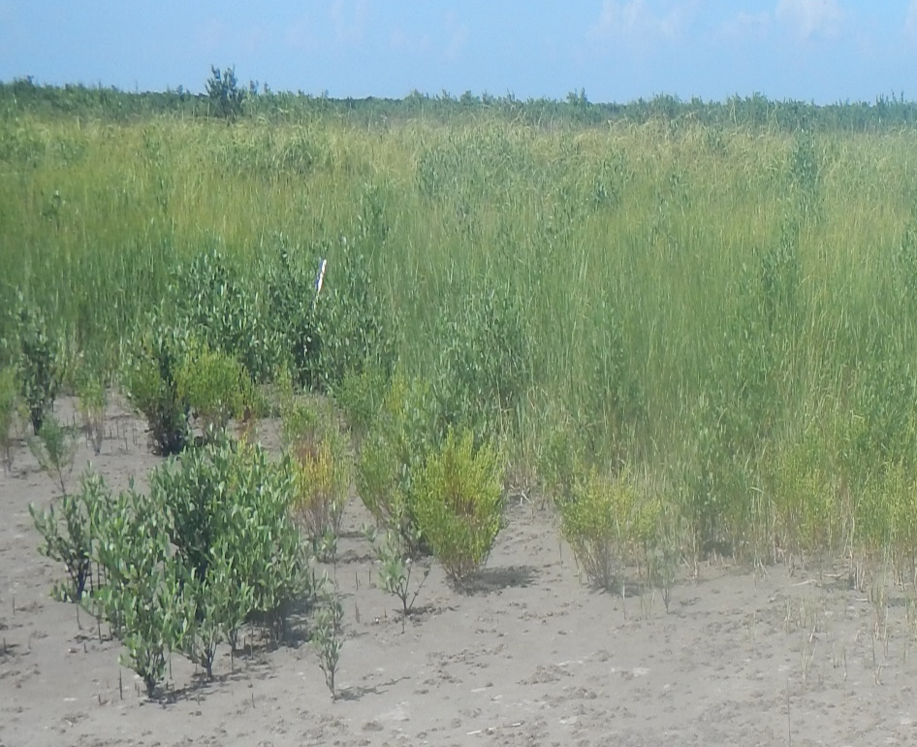
Habitat Restoration Program
Port Fourchon Mangrove Planting
April
2013
August
2014

Slide 7
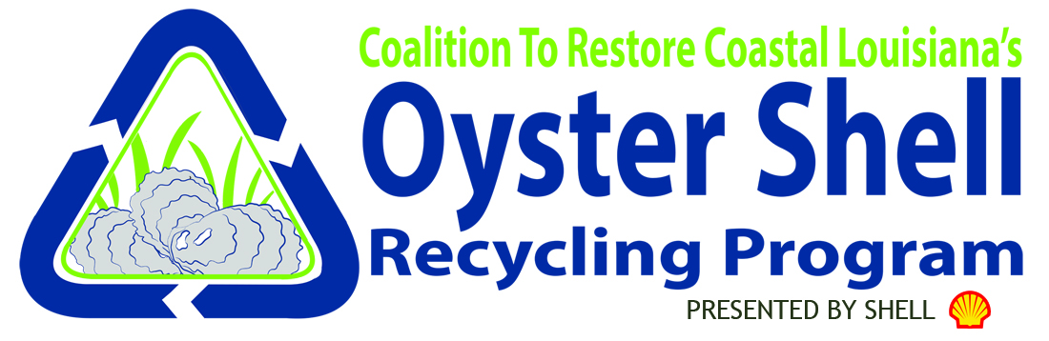
Oyster Shell Recycling
First shell recycling program in the state—Largest in the country!
Kicked off June 19, 2014
  2,150+ tons collected to date
26 participating Restaurants
Supported through a $1 million donation from Shell
  Additional support from LDWF, NFWF and CPRA
First reef to be constructed in the Biloxi Marsh (St. Bernard Parish) Fall/Winter 2016

Slide 8
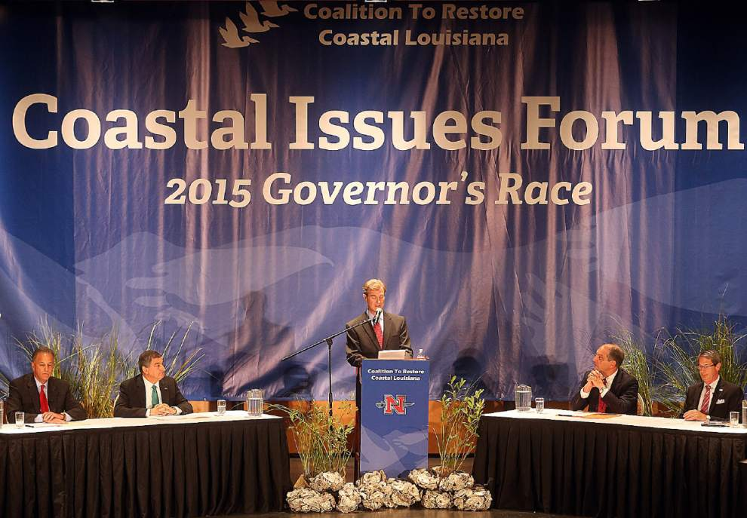
Coastal Issues Forum

Slide 9
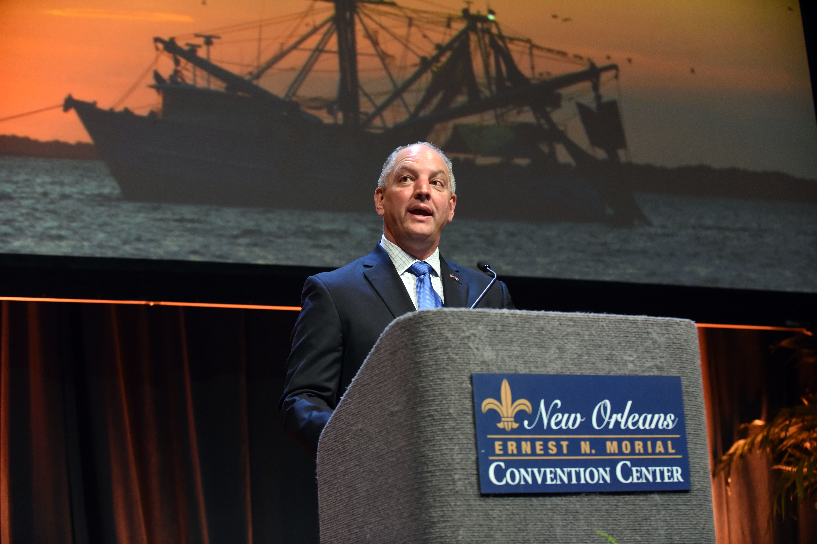
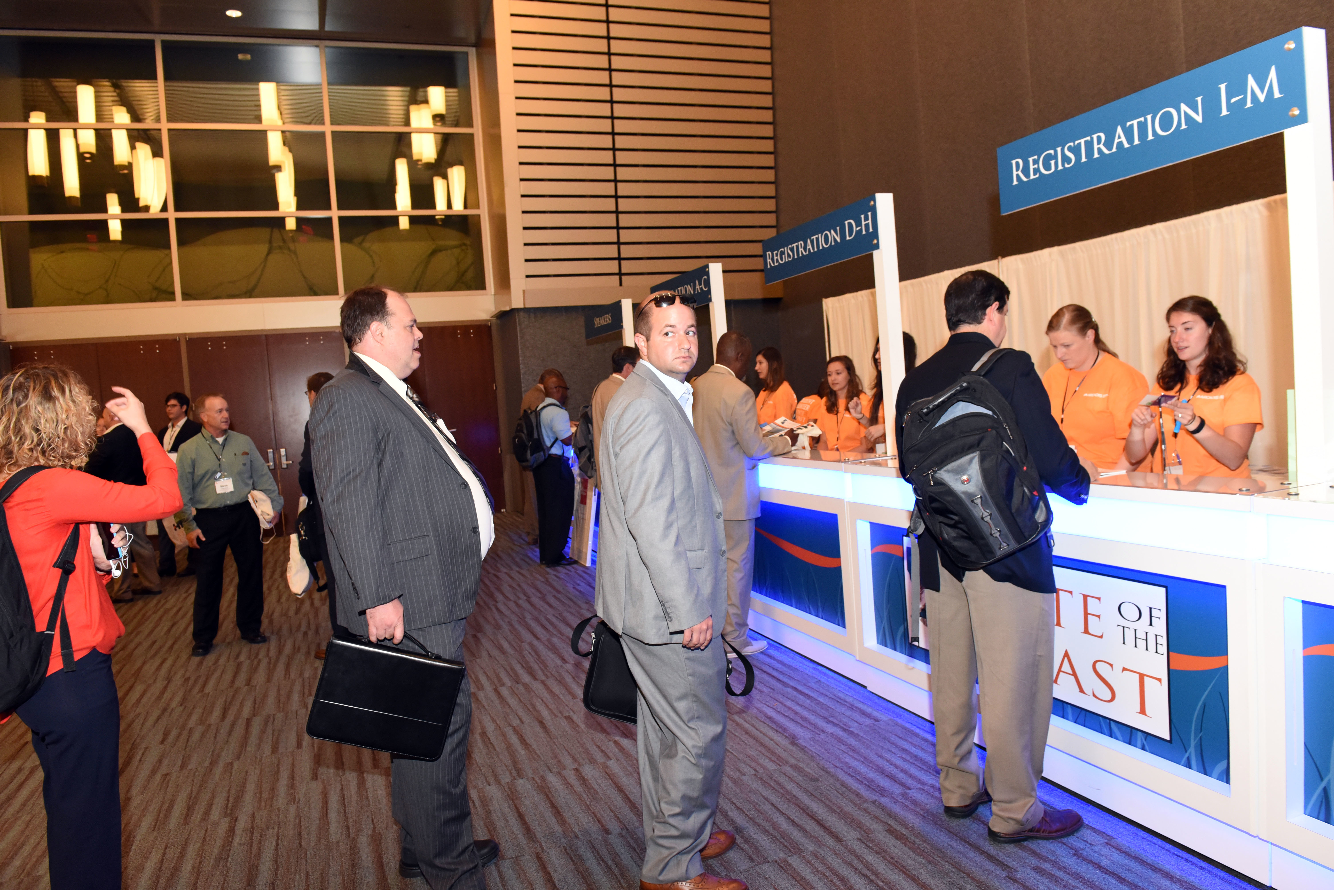
State of the Coast 2016
4th Biennial State of the Coast Conference
Largest gathering of coastal professionals, industry leaders and decision makers
Attendees from all over the Gulf South, the nation and the world
Program included 238 talks, 68 posters, 6 films and 10 panel discussions over three days.

Slide 10

Coastal Restoration Road Show
Series of informational meetings held throughout Louisiana’s Coastal Zone
High level overview of Louisiana’s coastal land loss crisis
Closer look at projects and restoration efforts specific to each area
Presentations in easy to understand language

Slide 11
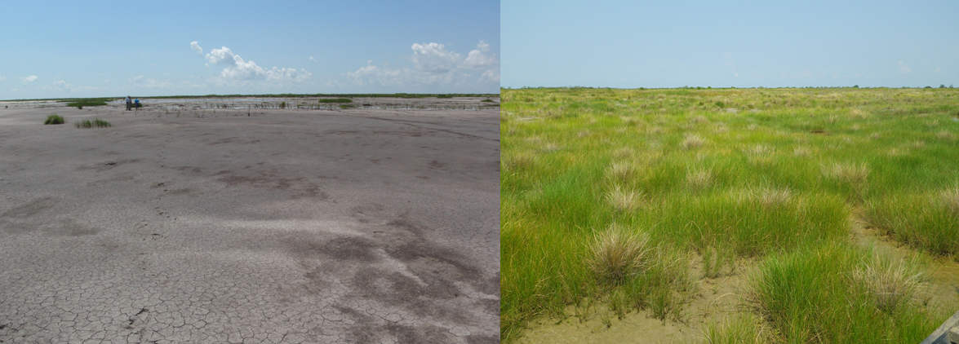
Monitoring - How well do our plantings work?
Big Branch NWR
2010
2013
Coalition To Restore Coastal Louisiana

Slide 12
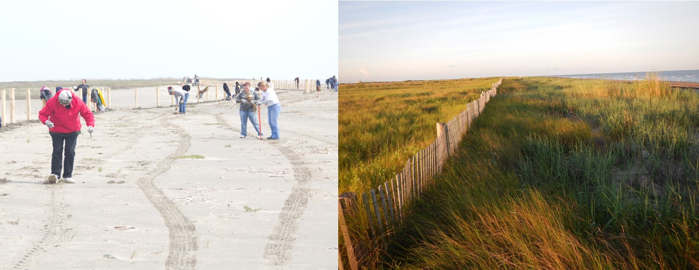
Monitoring – CRCL Projects
Grand Terre
2013
2014
Coalition To Restore Coastal Louisiana

Slide 13
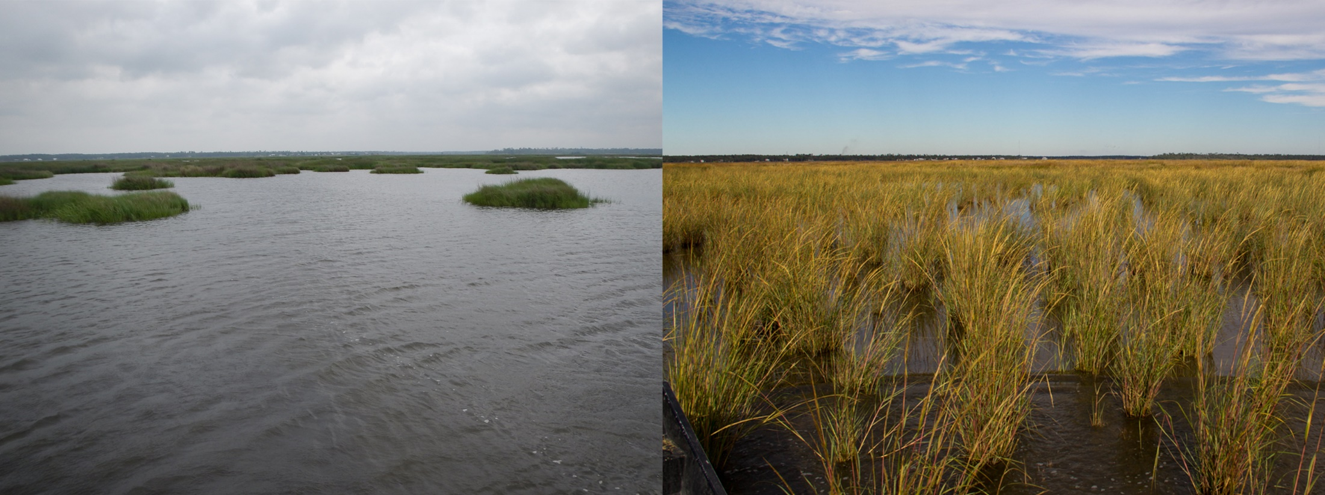
Monitoring – CRCL Projects
How well do our plantings work?
Are they sustainable?
April 2014
November 2014
Coalition To Restore Coastal Louisiana

Slide 14
Monitoring – CRCL Projects
How well do our plantings work?
Are they sustainable?
Establish monitoring for all plantings
Yearly site visits: salt marsh and dunes
Seasonal site visits: fresh marsh
Study a variety off variables:
  Number of plants
  % cover of plants
  Soil strength in plots
  Water level and salinity loggers
November 2014
Coalition To Restore Coastal Louisiana

Slide 15
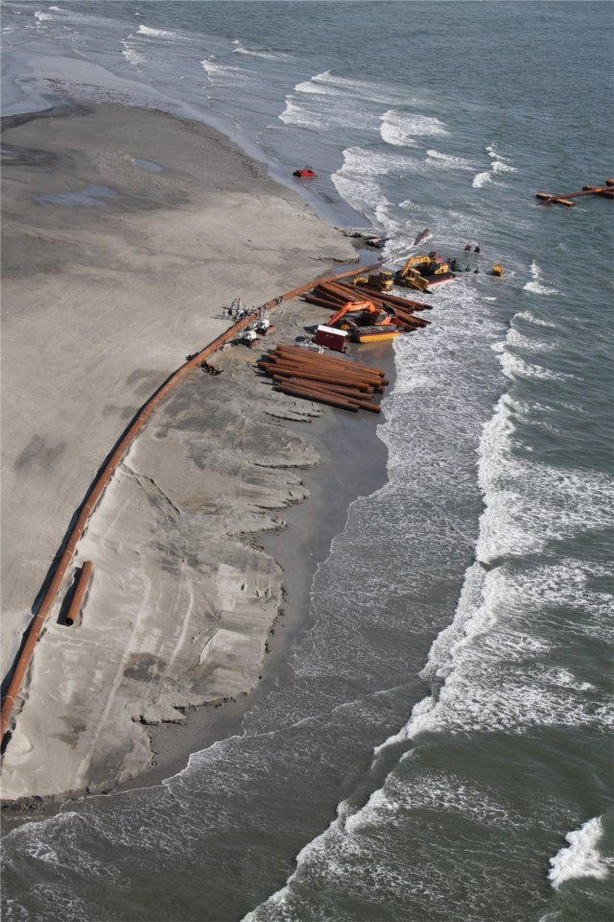
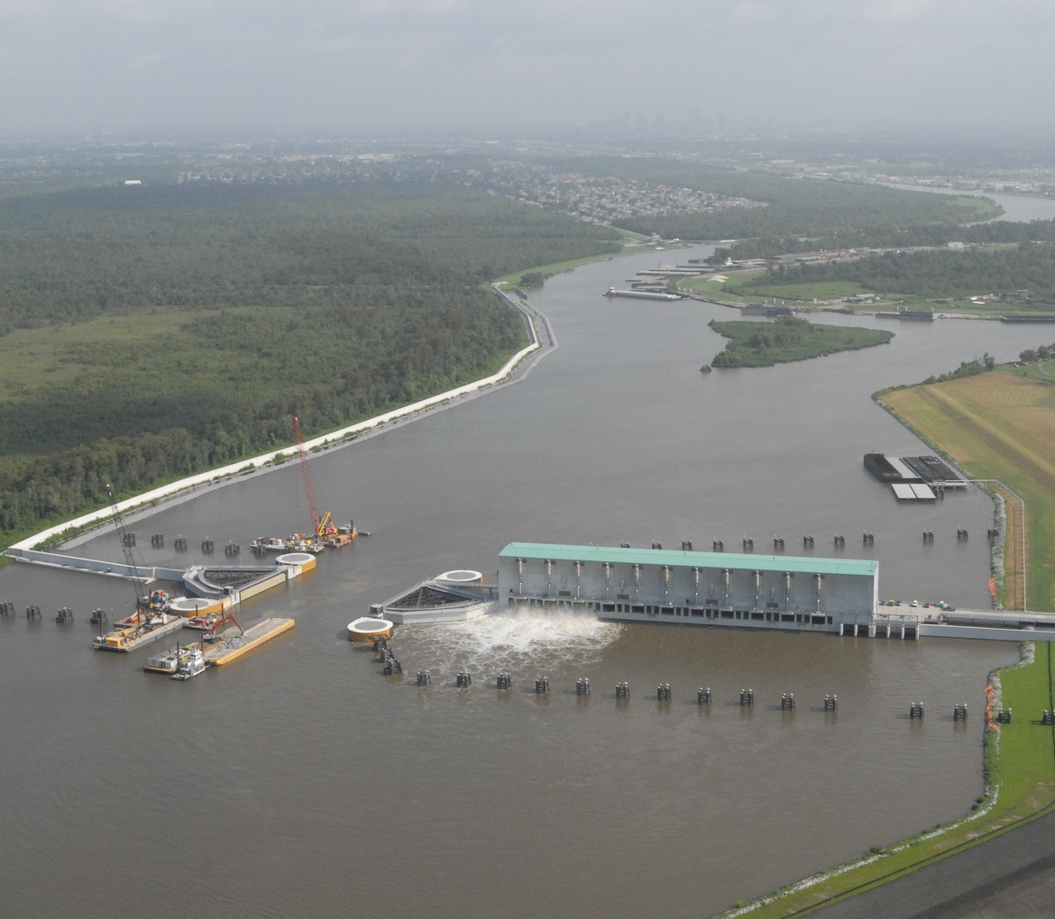
Monitoring – State of the Coast and Restoration Projects
Monitor amount of land actually created and sustained
Develop monitoring protocol for projects not building land directly
Use adaptive management to ensure future projects yield optimal benefits
Coalition To Restore Coastal Louisiana

