Slide 1
Canizaro Livingston Gulf States Center for Environmental Informatics
(GulfSCEI)
“Gulf Sea”
Thomas M. Soniat
08/05/16

Slide 2
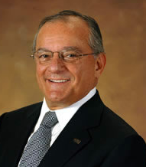
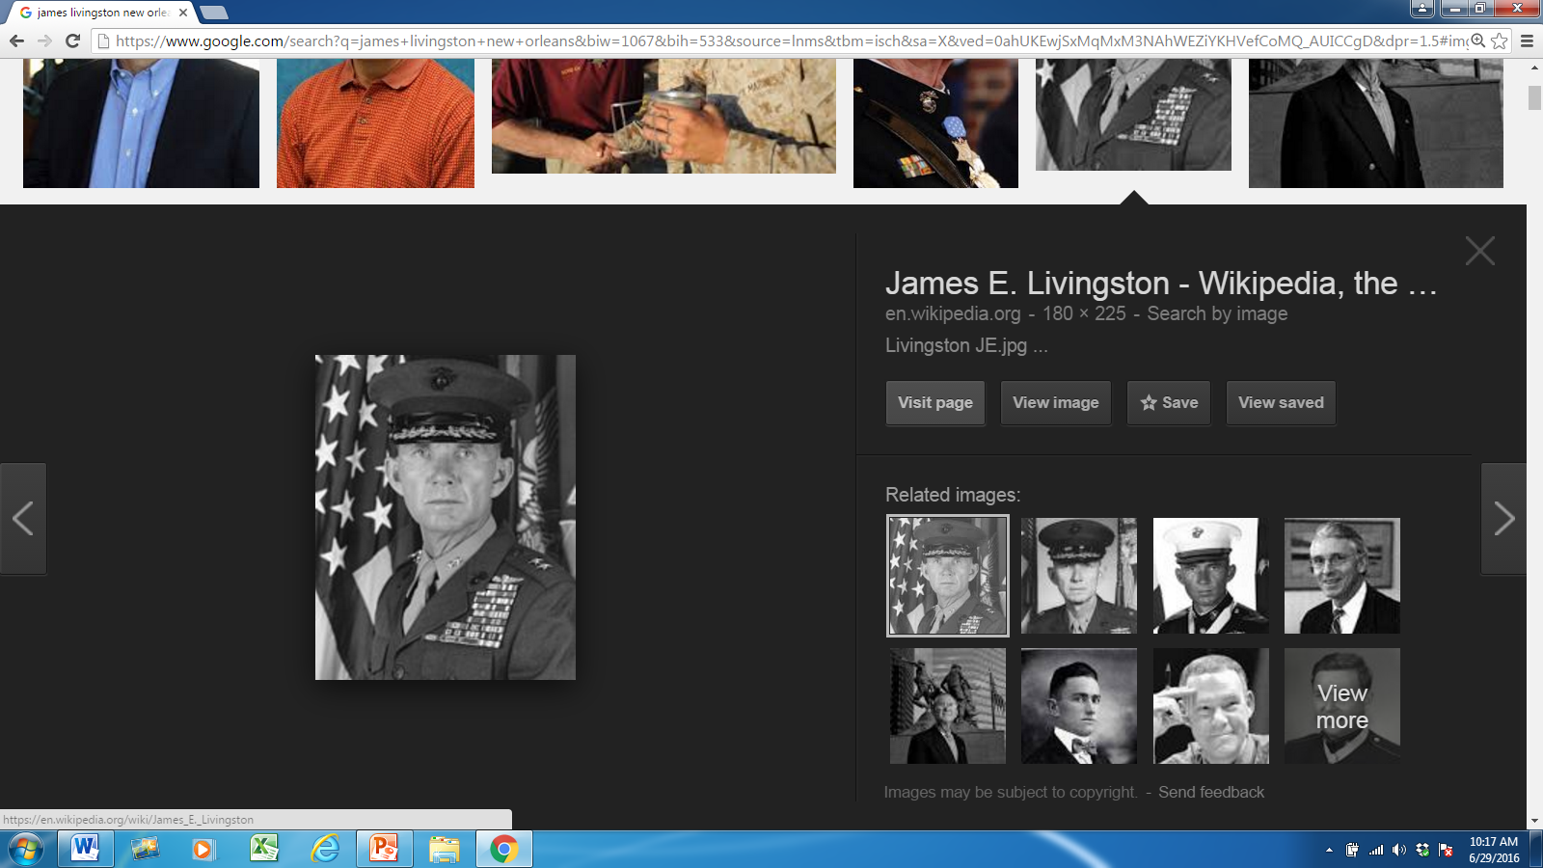
Namesakes
James Livingston
Joseph Canizaro

Slide 3
Center History
Established in September 2015 as a Louisiana Board of Regents Approved Research Center
One of four Centers within the UNO College of Sciences
Administered through the Department of Computer Science

Slide 4
What is Environmental Informatics?
EI is research and system development focusing on the environmental sciences relating to the collection, storage, processing, modeling, interpretation, display and dissemination of data and information.
Our approach is an integrator of multiple scientific disciplines for the expressed purpose of serving environmental management needs, with particular emphasis on the development of smart management systems.

Slide 5
Mission of GulfSCEI
Foster inter-disciplinary collaboration within the University of New Orleans and between investigators across the Gulf of Mexico
Empower scientists and engineers with modern informatics tools to solve environmental problems of the coastal margin of the US Gulf States
Assist state and federal agencies, non-governmental organizations and industrial partners to advance their educational, and research and development capabilities in environmental informatics
Train students in the theory and practice of EI

Slide 6
Faculty
Dr. Mahdi Abdelguerfi, Center Director; Professor & Chair, Department of Computer Science
Dr. Thomas Soniat, Associate Director; Professor/Research, Department of Biological Sciences
Dr. Shengru Tu, Professor, Department of Computer Science
Dr. Tamjidul Hoque, Assistant Professor, Department of Computer Science
Dr. Zibran Mohamed, Assistant Professor, Department of Computer Science
Dr. Christopher Summa, Associate Professor, Department of Computer Science
Dr. Tumulesh Solanky, Professor & Chair, Department of Mathematics
Dr. Bhaskar Kura, Professor of Civil and Environmental Engineering
Dr. Mark Kulp, Associate Professor, Department of Earth and Environmental Sciences.
Dr. Dimitrios Charalampidis, Chair, Electrical Engineering Department.
Dr. Abdul Rahman Alsamman, Associate Professor, Electrical Engineering Department
Dr. Ioannis Georgiou, Associate Professor, Department of Earth and Environmental Sciences

Slide 7
Student Research Assistants
Zhao Zang, Doctoral research assistant
Sumaiya Iqbal, Doctoral research assistant
Avdesh Mishra, Doctoral research assistant
Dustin Peabody, M.S. research assistant
Devin Frey, M.S. research assistant
Janak Dahal, , M.S. research assistant
Kristen Maus, Undergraduate research assistant
Samip Neupane, Undergraduate research assistant
Singh Perabjoth, Undergraduate research assistant
Christopher Perkins, Undergraduate research assistant
Brandon Berenato, Undergraduate research assistant

Slide 8
Research Staff
Daniel Ward, Senior Software Research Engineer
Nathan Cooper, Software Research Engineer
Charles Crawford, Software Research Engineer
Matt Toups, Information Technology Director

Slide 9
Research Activities

Slide 10
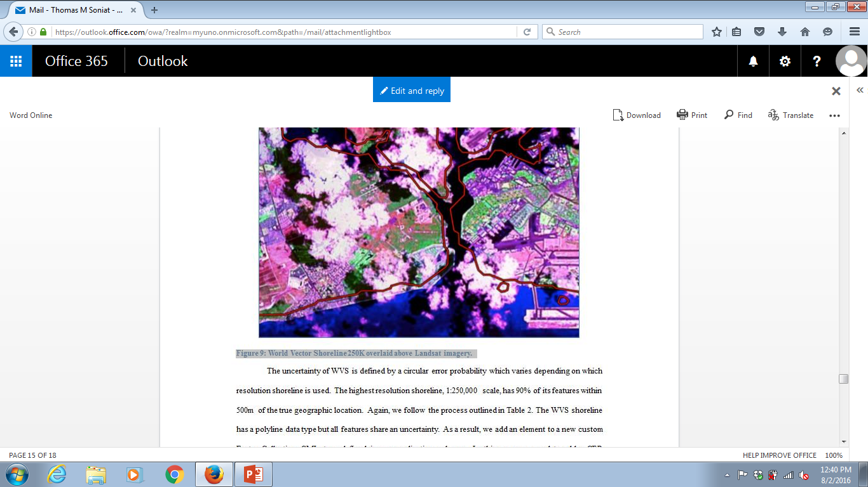
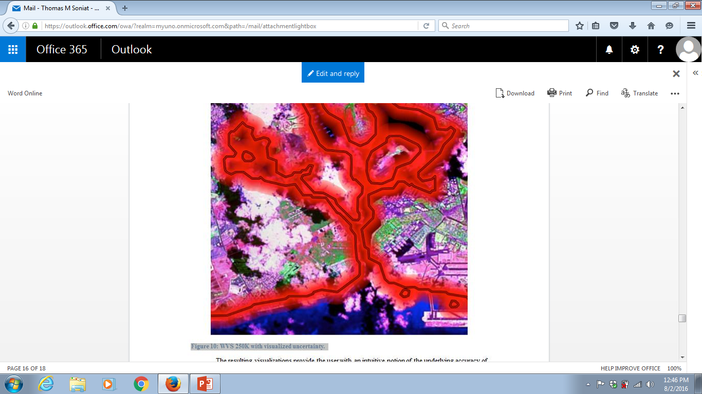
A Framework to Annotate the Uncertainty for Geospatial Data
WVS with visualized uncertainty
World Vector Shoreline overlaid above Landsat imagery

Slide 11
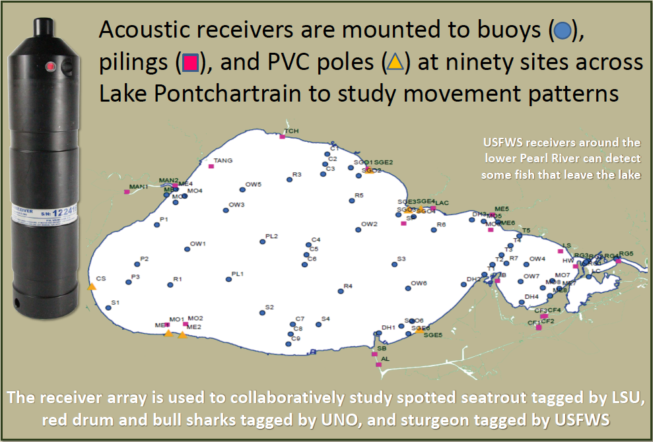
Environmental Geospatial Information Systems Development for the Louisiana Department of Wildlife and Fisheries (LDWF)

Slide 12
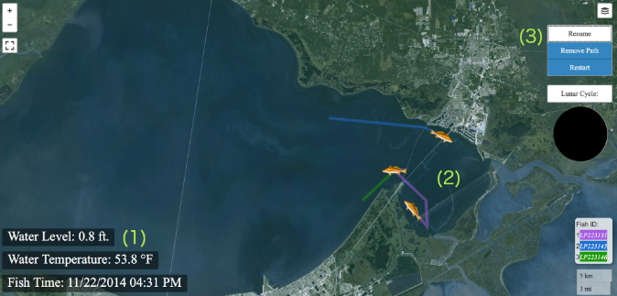
Environmental Geospatial Information Systems Development for the Louisiana Department of Wildlife and Fisheries (LDWF)

Slide 13
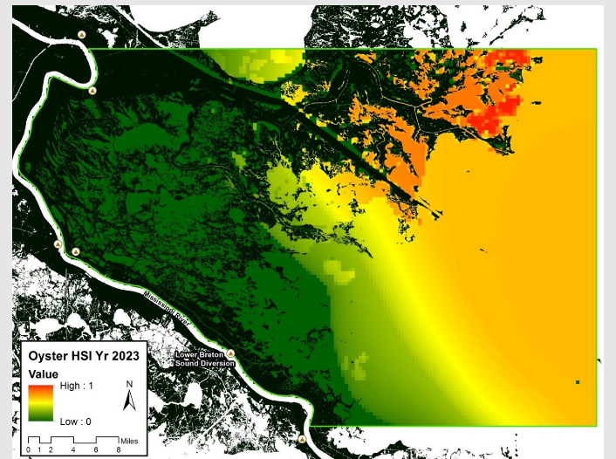
Freshwater Diversions into Estuaries

Slide 14
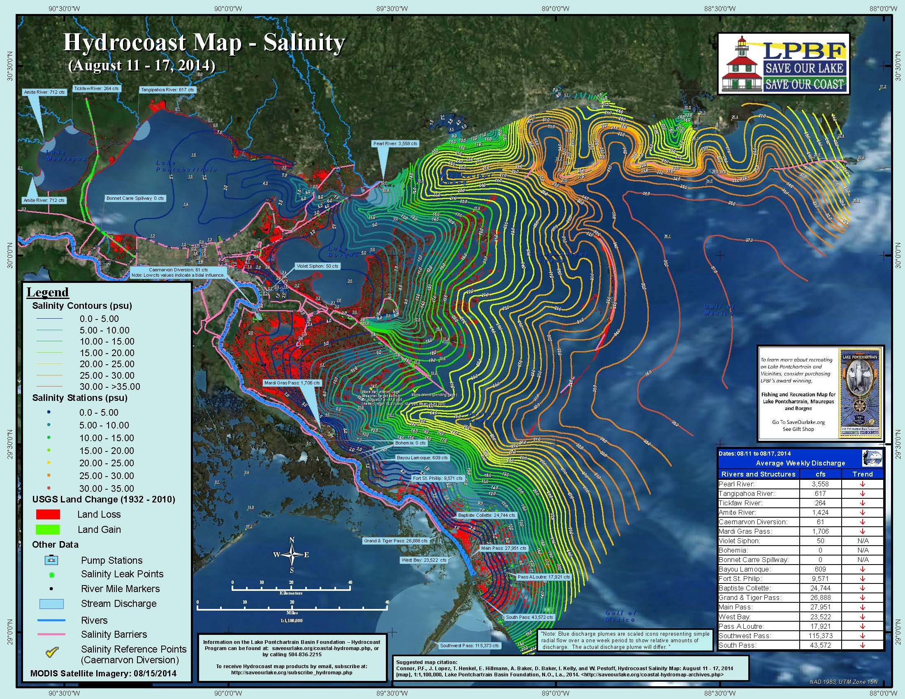
Freshwater Diversions into Estuaries

Slide 15
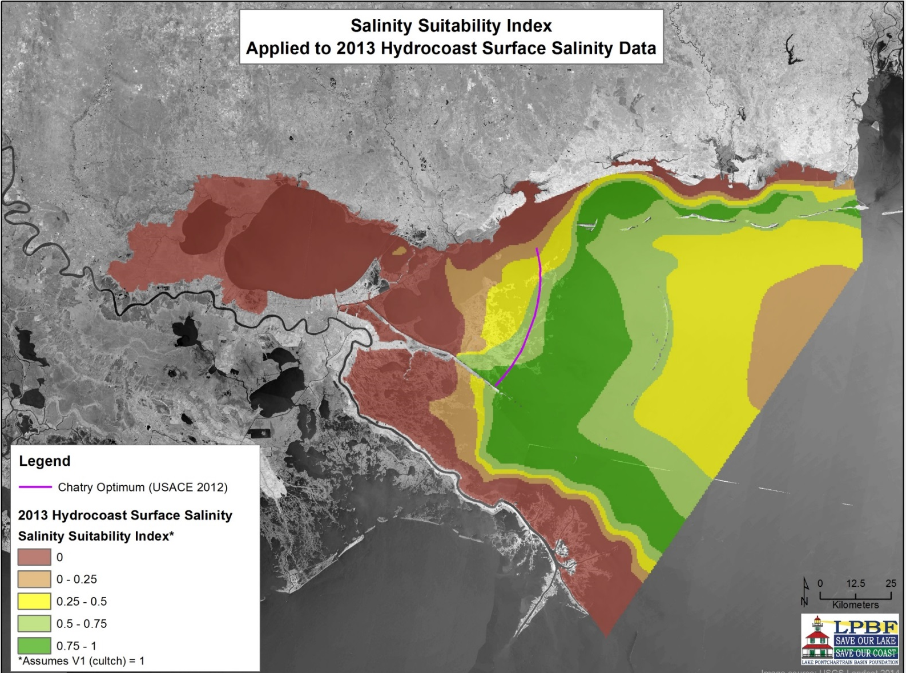
Freshwater Diversions into Estuaries

Slide 16
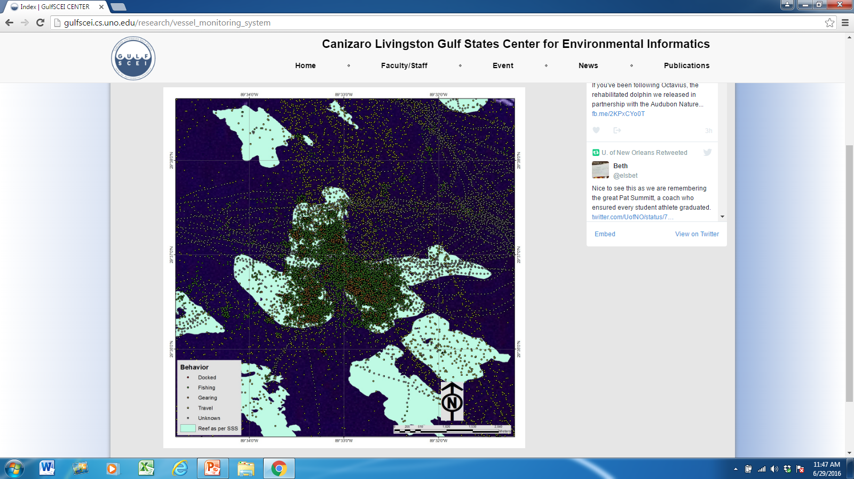
Vessel Monitoring Systems (VMS)

Slide 17
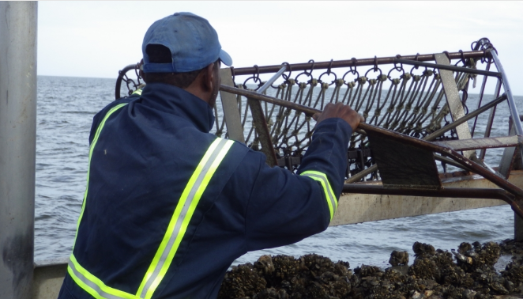
Sustainable Harvests of Oysters from Public Oyster Grounds

Slide 18
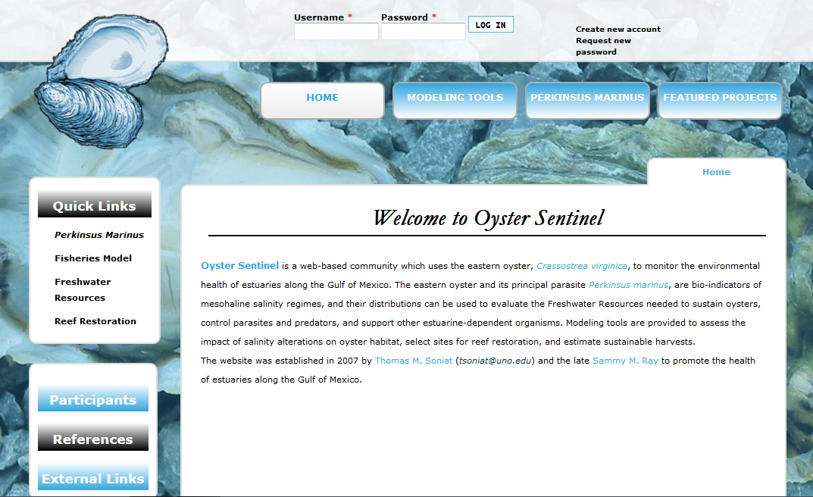
Sustainable Harvests of Oysters from Public Oyster Grounds

Slide 19
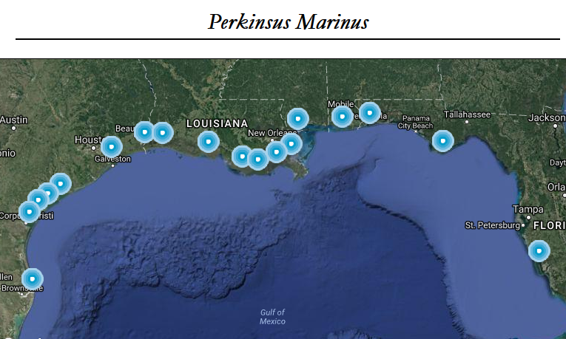
Sustainable Harvests of Oysters from Public Oyster Grounds

Slide 20
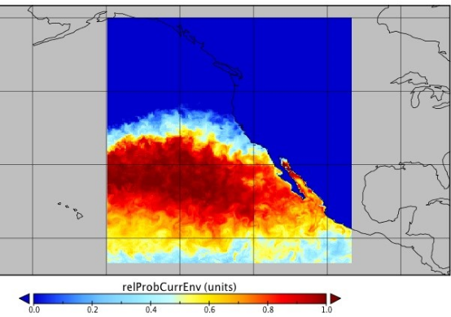
Spatial Data Mining: Analytical Environment for Large Scale Geospatial Data
Probability of Shark Appearance Calculated by Water Temperature and Salinity.

Slide 21
Latest Grants/Contracts
Soniat, T., (PI), Abdelguerfi, M., (Co-PI) “Maintaining Sustainable Oyster Production for the Louisiana Oyster Industry,” Louisiana Department of Wildlife and Fisheries. $770,111, Start date: 05/01/16, Duration: 3 years.
Abdelguerfi, M., (PI) “Large Scale Geospatial Data Mining using Hadoop and R System,” Naval Research laboratory, Stennis Space Center, MS., $999,994, Start Date: 1/1/2016, Duration: 5 years.
Abdelguerfi, M., (PI), Soniat, T. (Co-PI) “Environmental Geospatial Information Systems Development for the Louisiana Department of Wildlife and Fisheries (LDWF),” Louisiana Department of Wildlife and Fisheries, $834,532, Start Date: 7/1/2015, Duration: 3 years.

Slide 22
Latest Publications
Ioup, E., Z. Yang, B. Barre, J. Sample, K. Shaw & M. Abdelguerfi. 2015. Annotated uncertainty of geospatial and environmental data. IEEE Internet Computing 19(1):18-27.
Soniat, T. M., N. Cooper, E. R. Powell, J. M. Klinck, M. Abdelguerfi, S. Tu, R. Mann & P. D. Banks., 2014. “Estimating sustainable harvests of eastern oysters, Crassostrea virginica.” J. Shellfish Res. 33:381-394.
Soniat, T. M., C. P. Conzelmann, J. D. Byrd, D. P. Roszell, J. L. Bridevaux, K. J. Suir & S. B. Colley. 2013. Predicting the effects of proposed Mississippi River diversions on oyster habitat quality: application of an oyster habitat suitability index model. J. Shellfish Res. 32:629-638.

Slide 23
Summary
GulfSCEI promotes Research & Development in Environmental Informatics Gulf-wide
GulfSCEI trains the next generation in the theory and practice of EI
GulfSCEI assists faculty in traditional disciplines apply EI to their research
GulfSCEI creates smart management systems for Government Agencies, NGOs and the private sector

Slide 24
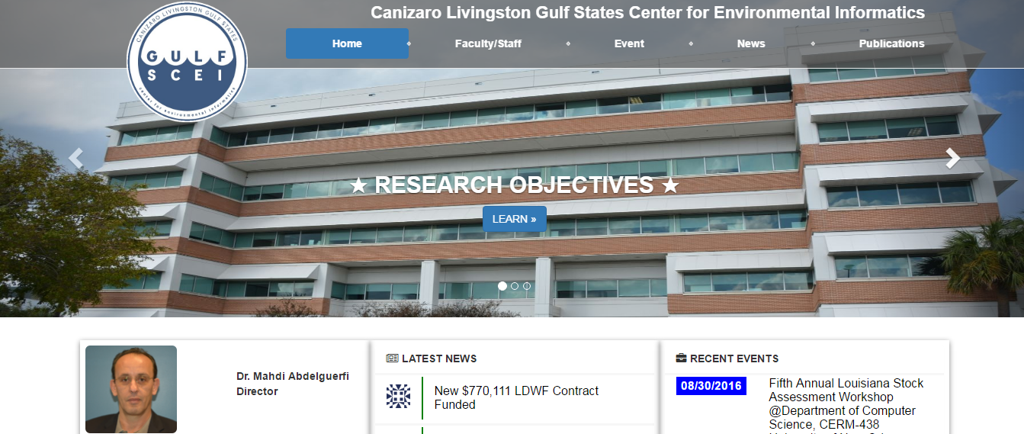
gulfscei.cs.uno.edu

