Slide 1
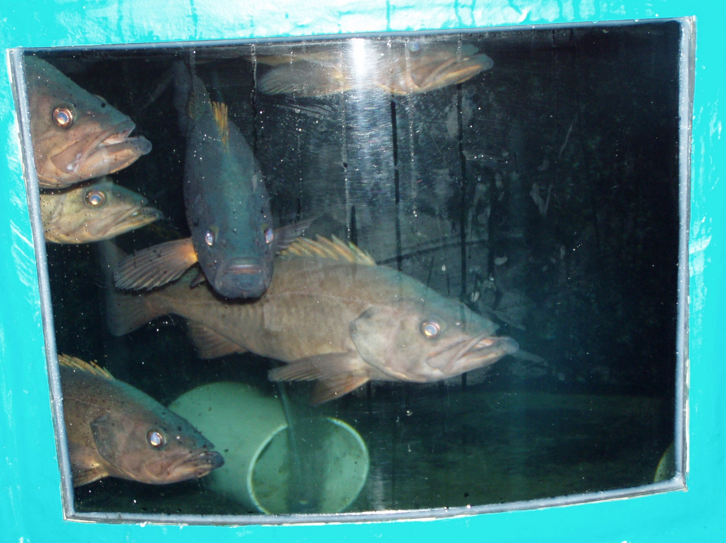
AST Filters ASTFilters. com
Water Filtration
Recirculating Aquaculture Systems
Research Labs
Zoos and Aquaria
Aquaponics
Schools
Wastewater
Dr. Ron Malone, P.E. Ron@Polygeyser.com (225) 802-2934 cell
Technical Director at AST Chevron USA Professor Emeritus
Civil and Environmental Engr. LSU

Slide 2
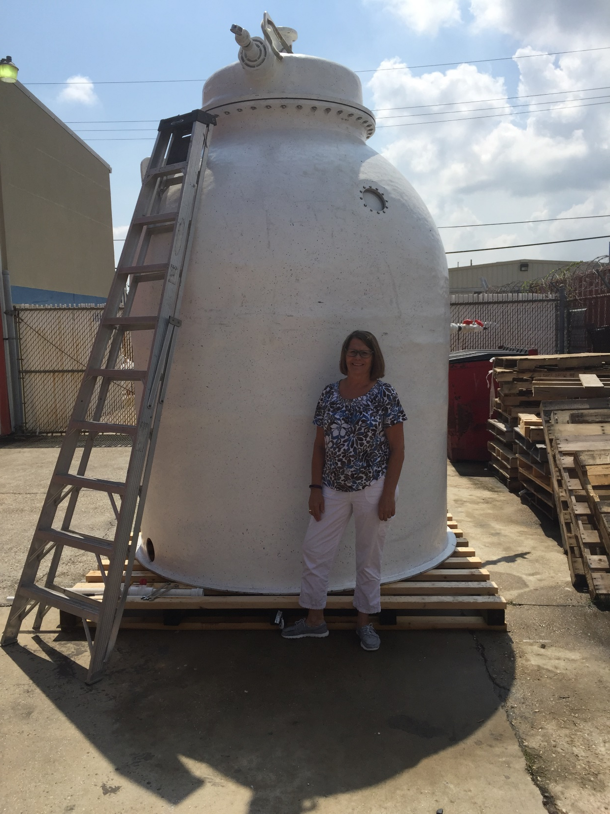
Why am I here?
Continuous SBIR since 1994
USDA, NOAA, NSF
Water Filtration, Algal Production
AST Provides matching to research grants
Principally at LSU
Several Faculty contributors
Licenses technology
Currently R& D unit at LSU Innovations Park

Slide 3
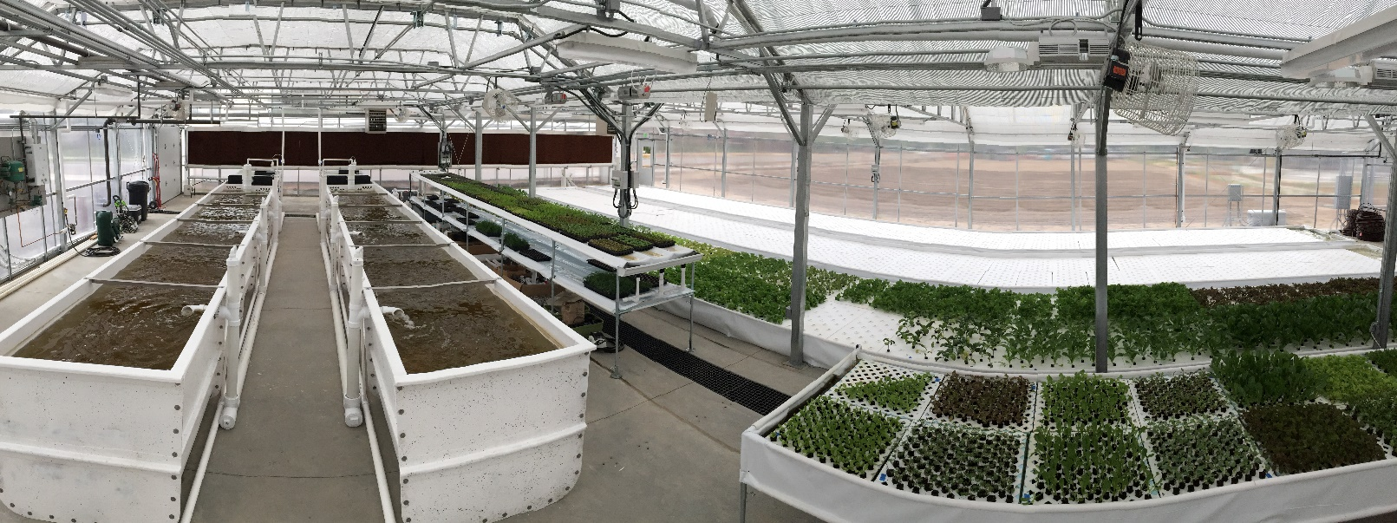
How to obtain SBIR funding
Professionally written proposal
Logical construct
NO WILD CLAIMS
Scientific rigor
Use Phase 1 to hire a proposal writer professor with a history of funding success
A good Idea
Improvement that leads to product/sales
Innovation
Scientific foundation
Speed to market
Market impact within 5 years?
Leave Plenty of lead time on forms
Deadlines are absolute
Letters of Support
Confirm markets

Slide 4
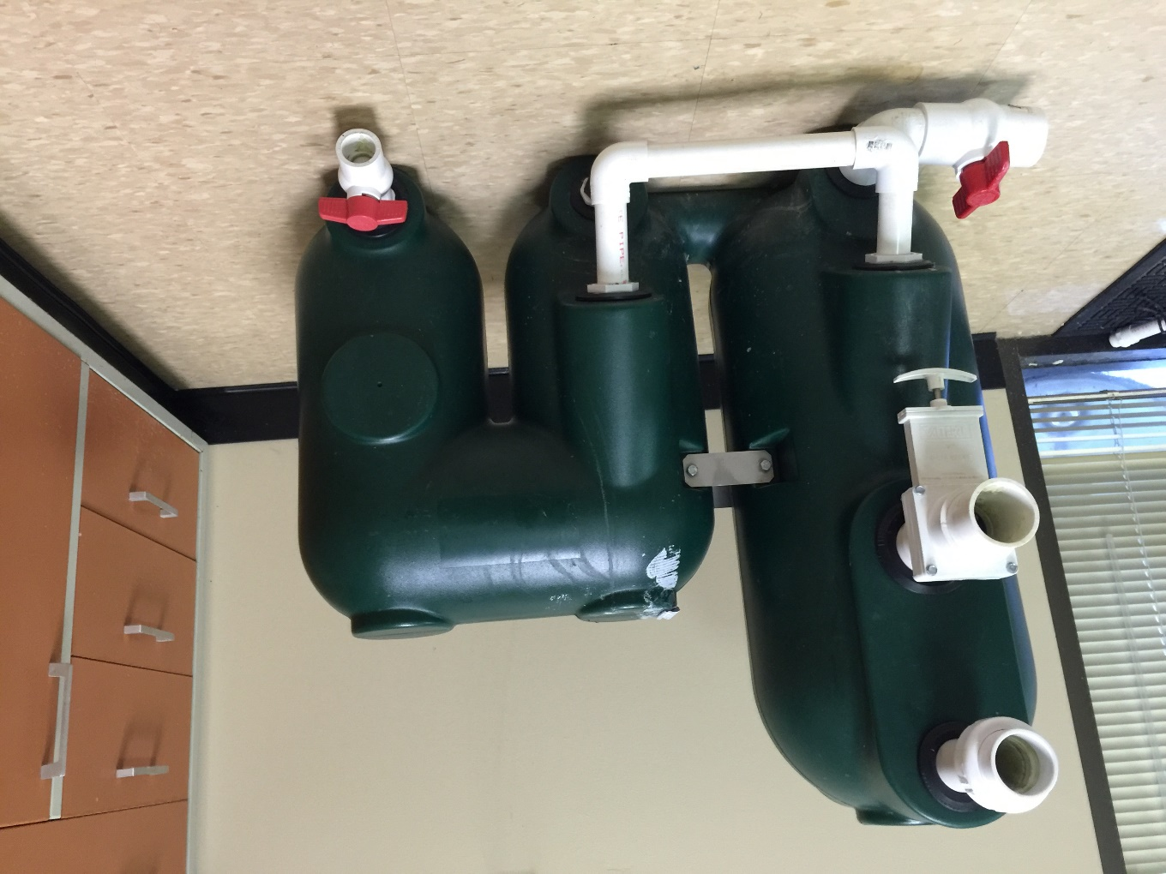
Benefits of SBIR funding
Builds professional staff in Science/Engineering
Forum for realistic ideas
Builds Data base!
Builds company Credibility
I got an SBIR
Quality of Staff
Company Visibility
Presentation and papers
New Product development
Years of sales

Slide 5
The SBIR Downside
Slow scientific process (2-5 years)
A lot of work to be done
On net cost money to implement
Inherent conflict between scientific research sector and short term business
Dr. Ron Malone, P.E. Ron@Polygeyser.com (225) 802-2934 cell
Technical Director at AST Chevron USA Professor Emeritus
Civil and Environmental Engr. LSU

