Slide 1
The water Institute of the Gulf
Nick Speyrer
August 5, 2016

Slide 2
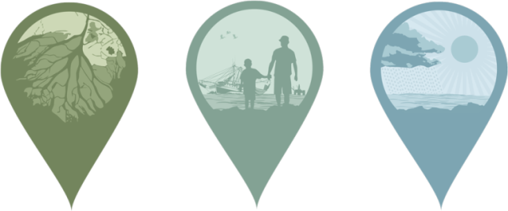
About Us
The Water Institute of the Gulf is the Center of Excellence and a not-for-profit, independent research and technical services resource for resilient coasts and sustainable water systems worldwide.
The work of the Institute helps ensure livable communities and a thriving economy and environment.
Notes:
Began operations in February 2012
Operations based in Baton Rouge, Louisiana
Founding Partners: State of Louisiana (Governor Jindal), Baton Rouge Area Foundation, Senator Mary Landrieu

Slide 3
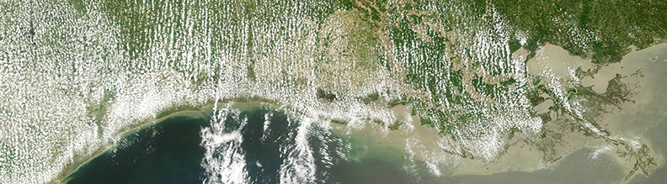
Our Goal
To bring an interdisciplinary approach to understanding the complex dynamics of coastal, deltaic and water systems and develop tools that can be applied to address challenges facing society.

Slide 4
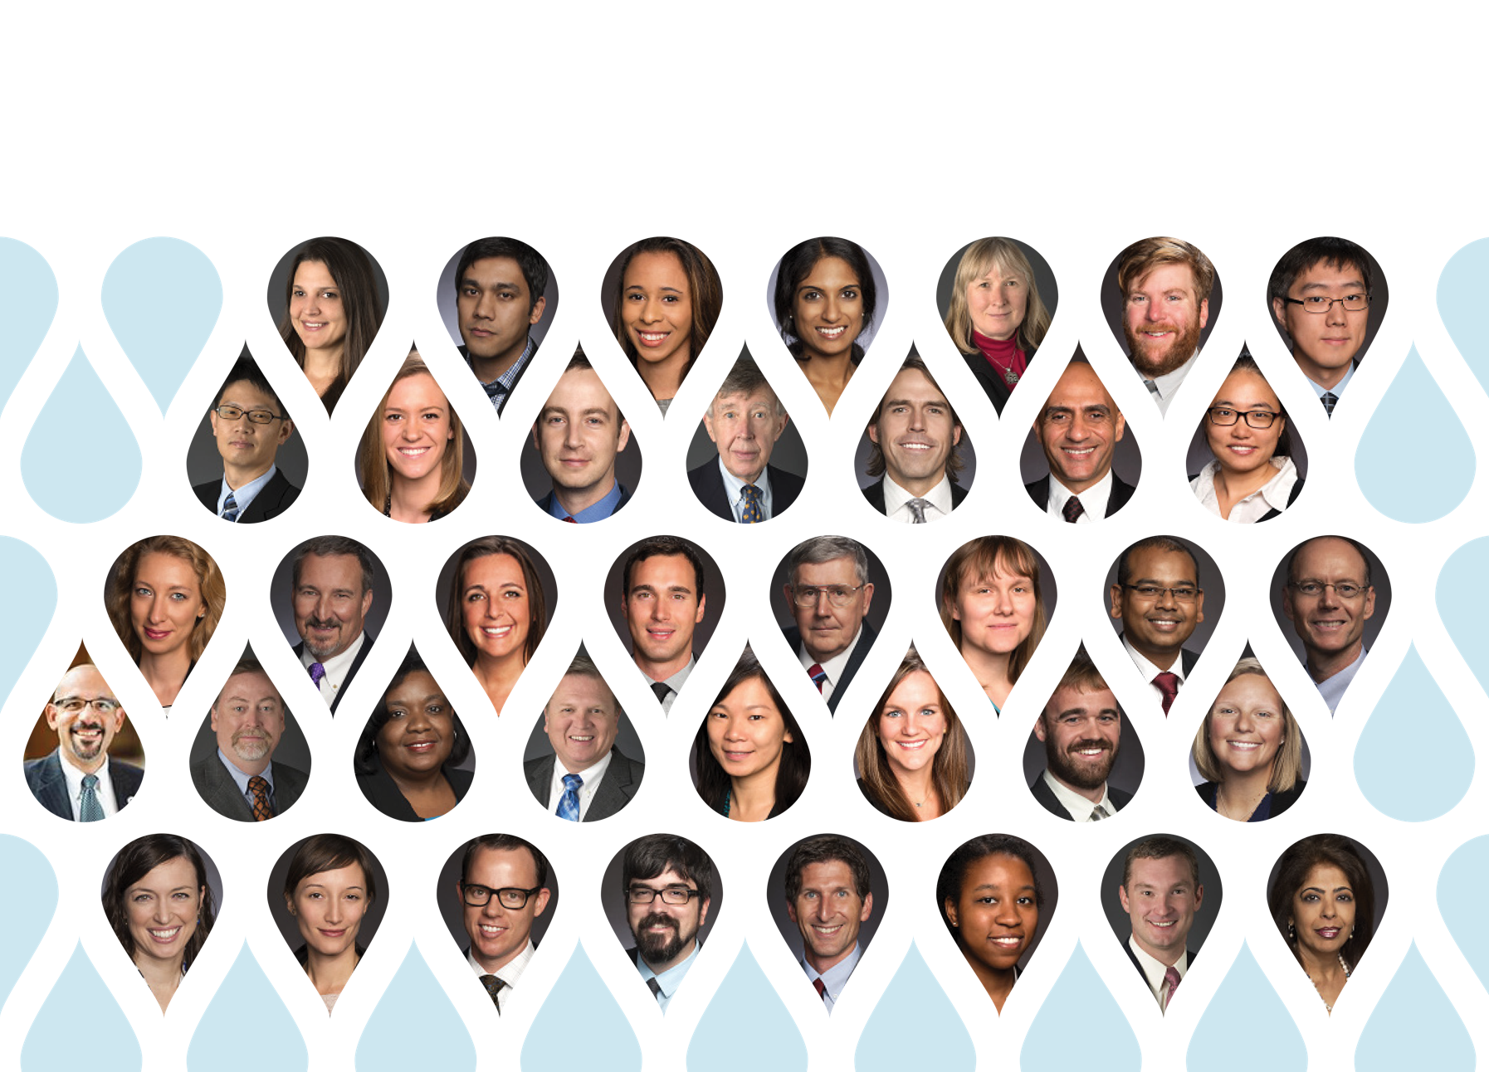
A DIVERSE, WORLD-CLASS TEAM

Slide 5
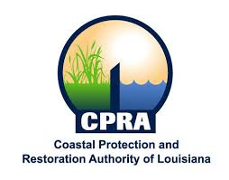
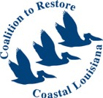
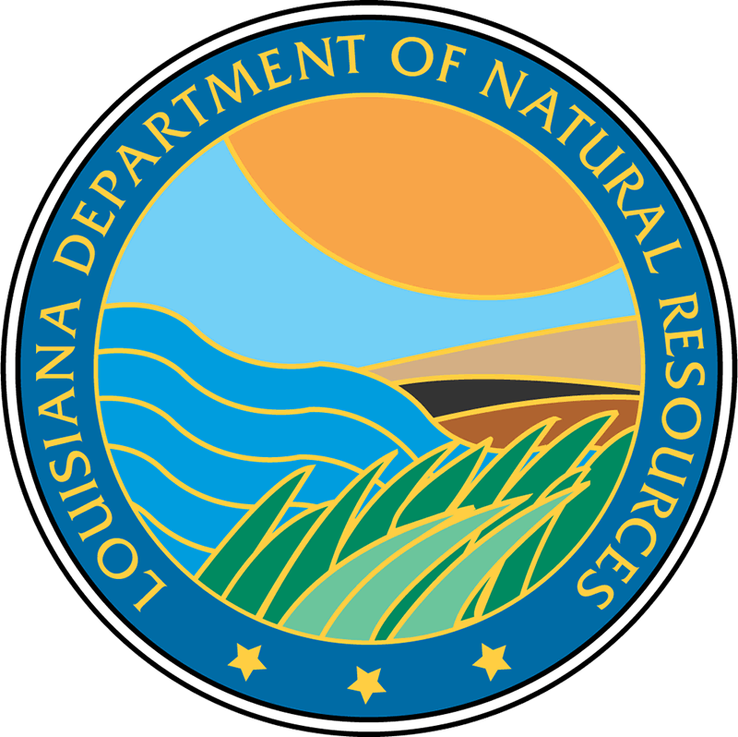
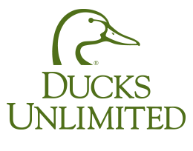
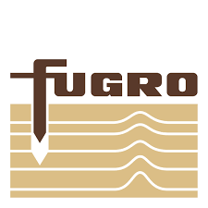
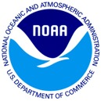
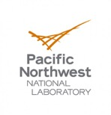
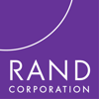
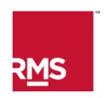
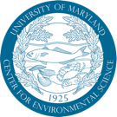
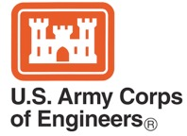
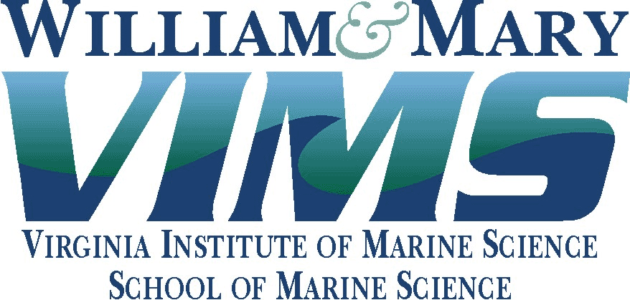
Experienced Partners

Slide 6
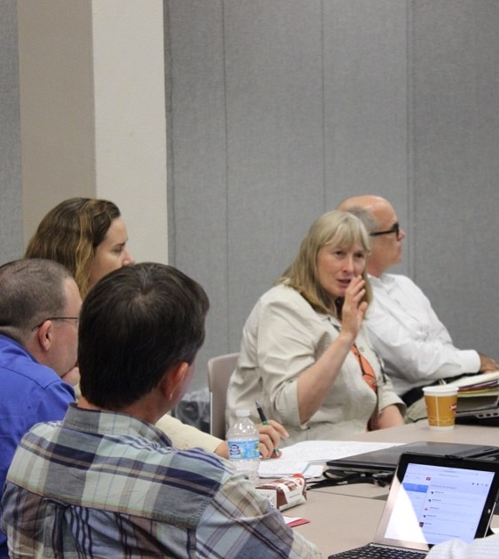
Suite of Services
Applied Research
Technical Support
Field Investigations
Real-time sensor data collection and monitoring design
Integrated natural systems modeling
Analytics and integrated decision support
Spatial analysis of socioeconomic and ecosystem change
Independent technical expert review
Expert opinion and advisement

Slide 7
Specific expertise at the Water Institute
Synthesizing coastwide and local trends in infrastructure
Deploying a wide range of boat-based and fixed-station observational studies of riverine, deltaic, coastal, and offshore environments
Linking physical, ecological and societal aspects of coastal change
Coastwide modeling of landscape change
Detailed sediment, water, biological process model
Local modeling of structures and protective actions, including green infrastructure

Slide 8
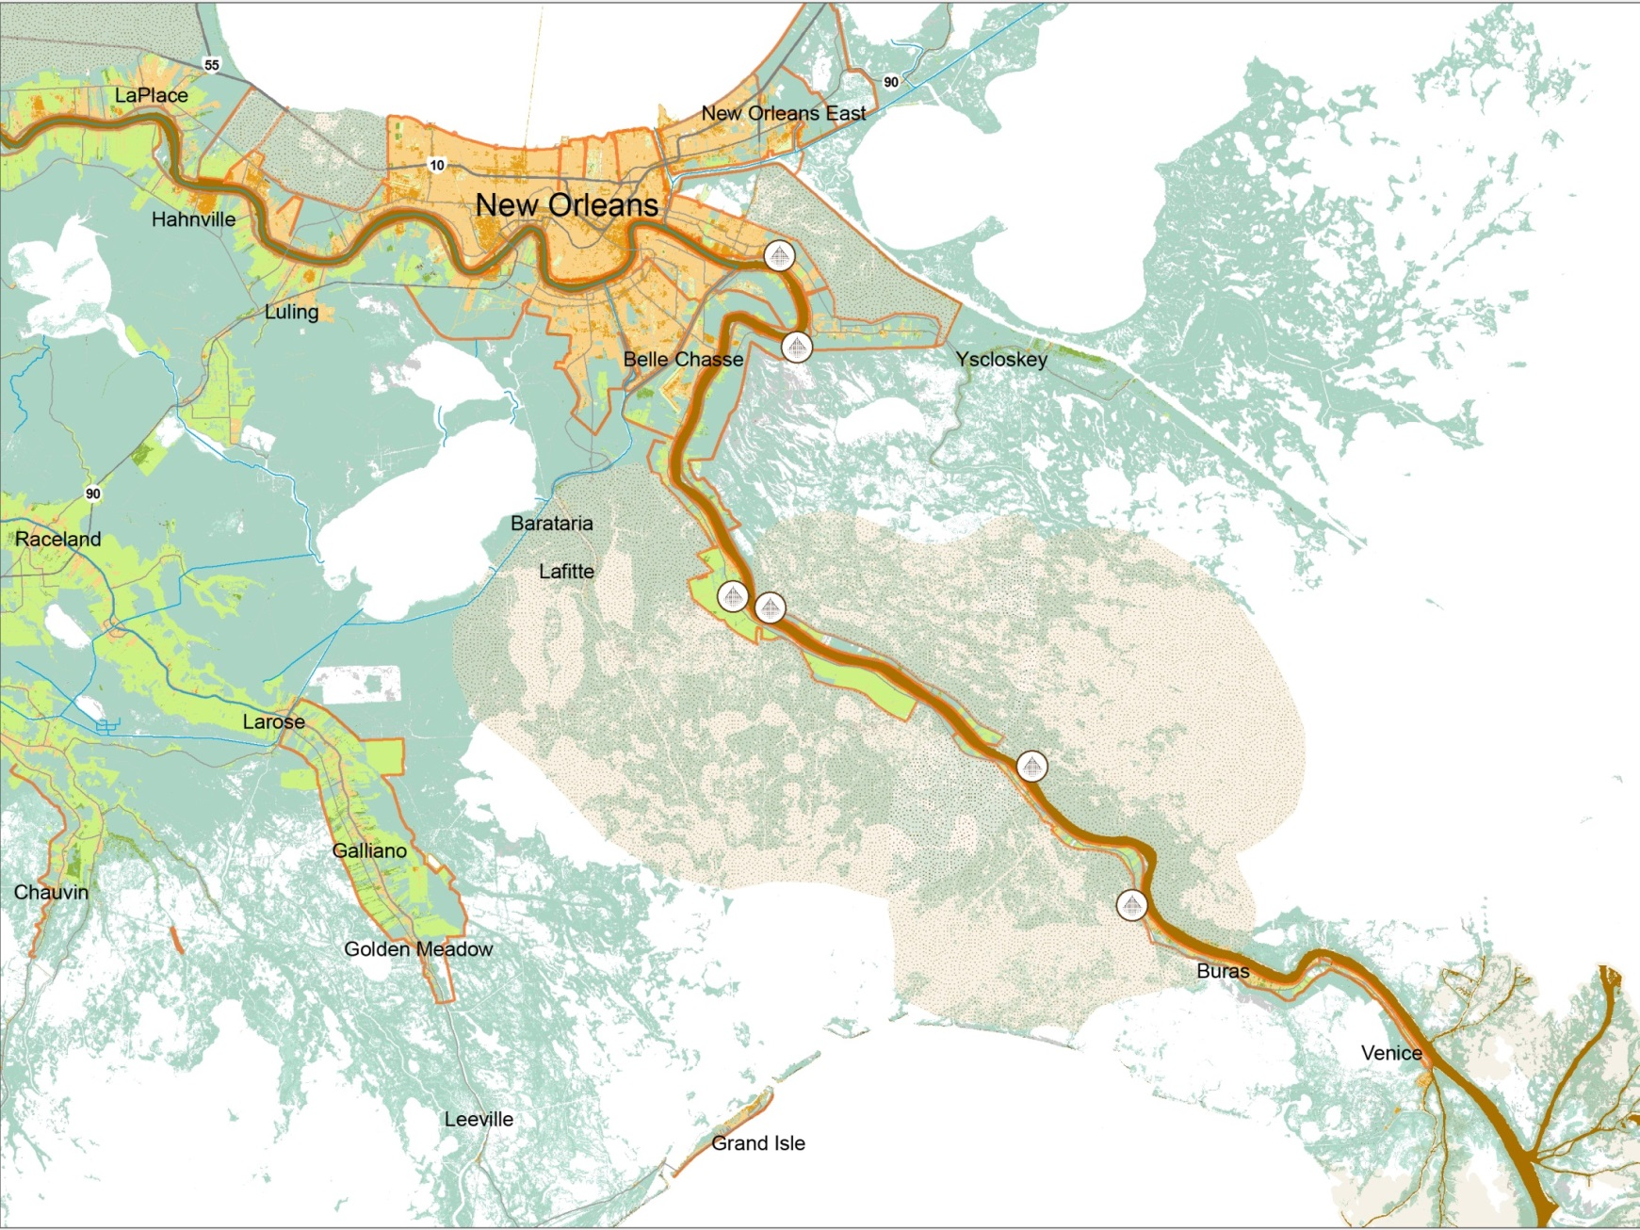
AN integrated approach to solving the challenges of Coastal Louisiana and the Mississippi river delta
Modeling and Monitoring
Physical Processes and Sediment Systems
People, Resources, and Technology
Coastal Systems Ecology
Policy Research
Notes:
Our modeling is unique because we integrate such a variety of data types for a more comprehensive understanding of patterns and impacts.

Slide 9
Linking Knowledge to Action: The Institute’s Role in Louisiana Coastal Protection and Restoration
PROJECT EXAMPLES
Master Plan Model Development
Coastal Louisiana Model Tool Development:
Land Building
Fisheries
Nutrients
Sediment Diversion Project Planning
Coastal Monitoring Framework
Louisiana Coastal Atlas
Water Resource Assessment
Notes:
The Water Institute is building its own in-house expertise, but it also functions as a hub for innovation. We depend on our partnerships with academia, NGOs, industry, and government agencies to help us examine challenges in depth, without duplicating efforts.
We believe these partnerships will lead to a new water management industry in Louisiana that will lead to opportunities to export our research and private sector expertise to developing coastal areas worldwide.

Slide 10
Integrated Decision Support: Real-Time Monitoring and Modeling

Slide 11
Supporting Innovation
Programs and Support
Coastal Innovation Partnership Program
Applied Research and Technical Support Capabilities
Center of Excellence Research Program
CPRA Applied Research Program
System Test, Launch & Operations
TRL 9 TRL 8 TRL 7 TRL 6 TRL 5 TRL 4 TRL 3 TRL 2 TRL 1
System/Subsystem Development
Technology Demonstration
Technology Development
Research to Prove Feasibility
Basic Technology Research

Slide 12
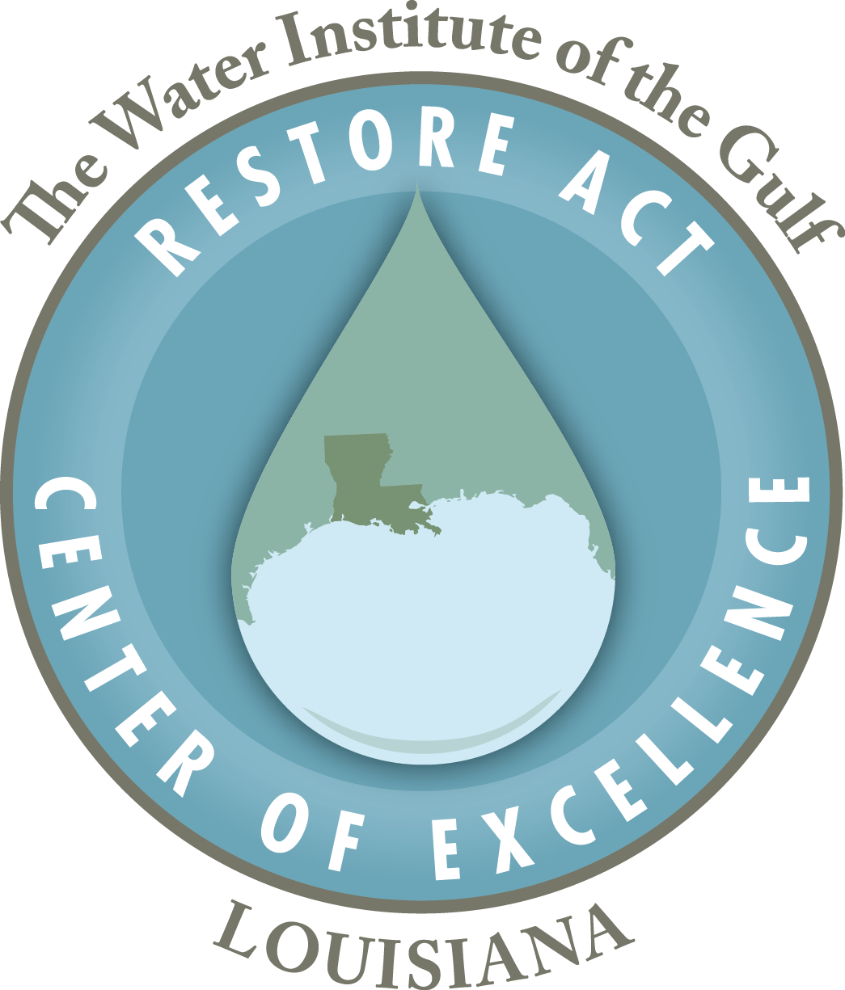
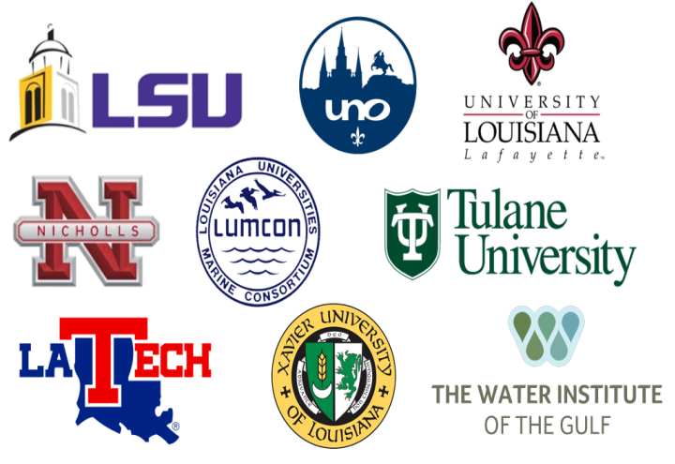
Center of Excellence
Notes:
Designated Louisiana’s Center of Excellence in February 2014
Delayed in establishing due to Treasury Regulations
Application sent to Treasury on July 31, 2015; approved October 19, 2015
Contract under development
Potential Available Funds
Funding
Transocean ($1 B)
~$4 million
Now
BP ($5.5 B)
~$22 million
Estimated as early 2017 (1 year after signed consent decree)
Available over 15 years – so approx. $1.4 M/year

Slide 13
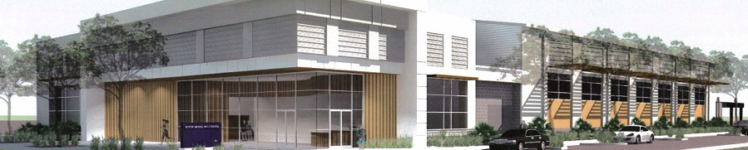
Water Campus

Slide 14
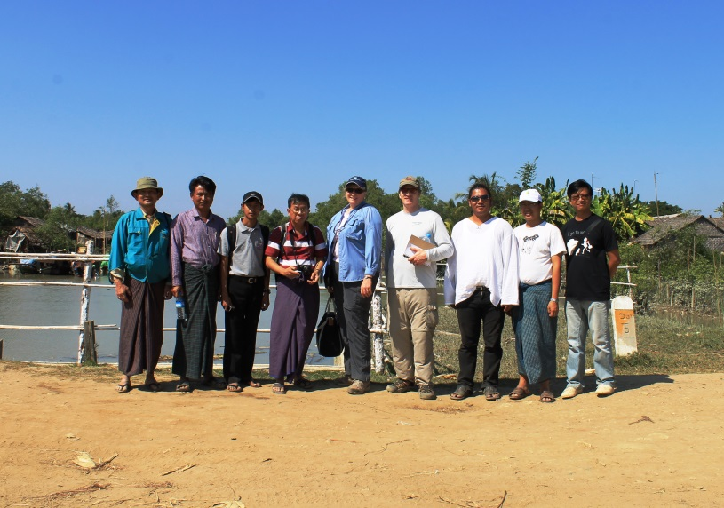
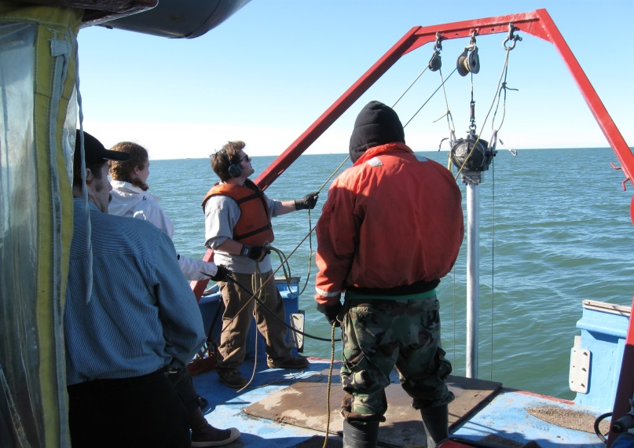
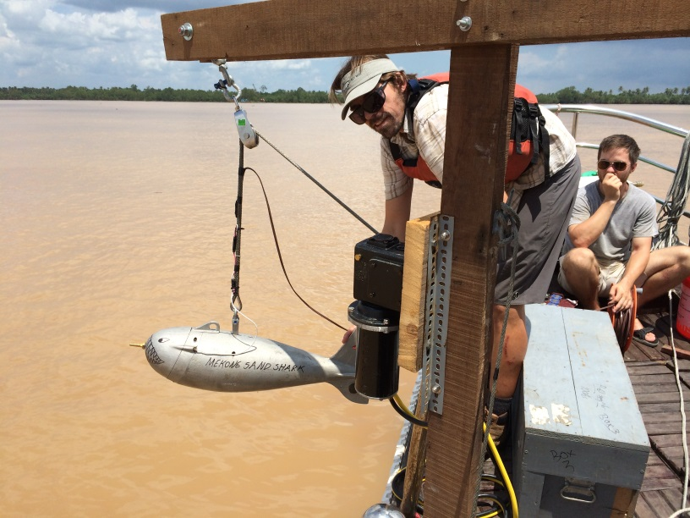
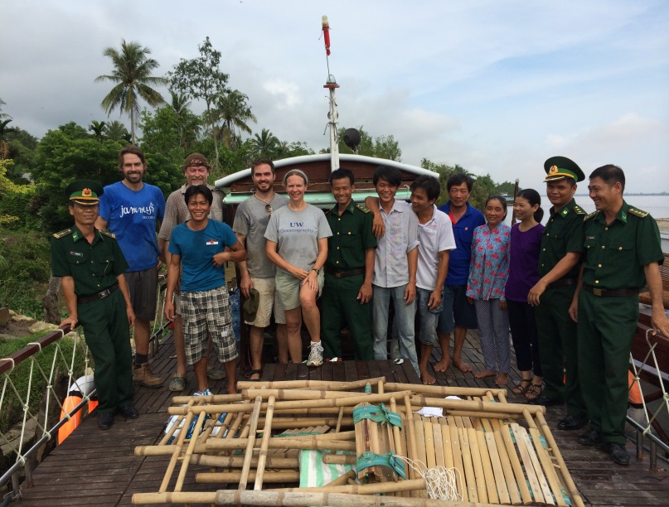
Beyond Louisiana’s Borders

Slide 15
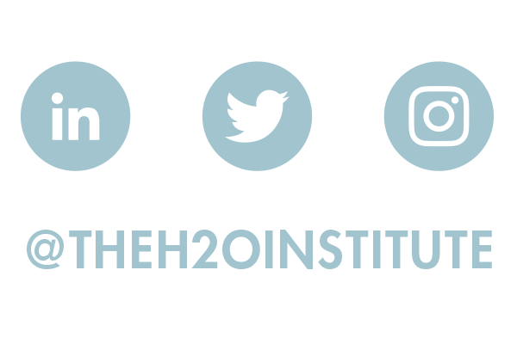
Nick Speyrer nspeyrer@thewaterinstitute.org

